Slide 1
G4J team
Growth for Jobs Strategy
Overview presentation

Slide 2
Growth for Jobs Strategy
Notes:
Introduction
Like the rest of South Africa, the Western Cape faces a range of deep, interconnected, socio-economic challenges that include unemployment, poverty and crime. While there is no panacea for these challenges, which have deep roots in the country’s history and social structure, there is also no prospect of addressing any of them without faster economic growth. Economic growth is essential to generating rapid and sustained job creation, faster growth in living standards and increased resources available to society. The Western Cape Government identified the need for a strategy to lift dramatically the provincial growth rate and, to the extent that growth continues to falter in South Africa, to decouple the province’s growth trajectory from that of the rest of the country.
Therefore, this Growth for Jobs Strategy sets out a comprehensive, challenging and ambitious goal for the Western Cape to grow its economy by between 4 and 6% by 2035.
It is also a strategy that clarifies that how we grow our economy is as important as the growth itself. In this way, the Growth for Jobs Strategy distinguishes itself from previous strategies, by providing a long-term perspective with clear targets, framed within defined principles. It is centred on systemic solutions that address key binding constraints and an enabling environment for the private sector that accelerates our economic growth.
The formulation of the Growth for Jobs Strategy has been data-driven, evidence-led and has involved extensive consultation. It draws on a provincial Growth Diagnostic completed in 2022 and involved a team of officials and independent experts who engaged with stakeholders from the private and public sectors, and representatives from across civil society and academia.
The Growth for Jobs Strategy process drew from three surveys that were conducted and disseminated through private-sector channels, drawing in the views of over 540 stakeholders. Furthermore, during the strategy formulation process, the Western Cape Government consulted over 2000 people and industry representatives (and their constituents representing more than 30 000 individuals) over the course of 188 engagements.
At its heart, the Growth for Jobs Strategy is premised on a recognition that the private sector creates jobs, while the State needs to create an environment in which people and businesses are enabled to create and exploit opportunities as they arise. This kind of ‘horizontal’ enablement empowers citizens and fosters independence, freedom, and self-reliance.
To give effect to this approach, the Growth for Jobs Strategy has several important anchors:
Clear principles set out in a strategic framework that have guided thinking and decisions.
Crucial priority focus areas (PFAs) that shape decisions around the nature of the interventions needed to maximise impact.
Key levers, enablers and accelerators that facilitate the achievement of these goals.
Finally, the Growth for Jobs Strategy is a whole-of- government, all-of-society strategy whose success requires the energy, commitment and allocation of resources from across government, the private sector and civil society.

Slide 3
Problem Statement
Tracking South Africa with its low growth rate,
the Western Cape Province is NOT GROWING FAST ENOUGH to reduce high unemployment.
South Africa and Western Cape GDP growth rate (2019−2027)
Western Cape employment (2019Q1–2023Q1)
No of employed (thousands)
Western Cape unemployment (2019Q1–2023Q1)
Notes:
Upward trend in unemployment over the last 13 years, yet unemployment rose by more than 500k persons
1% growth in unemployment > 0.6% employment growth
Population growth of 2% per annum implies we need more than 3%

Slide 4
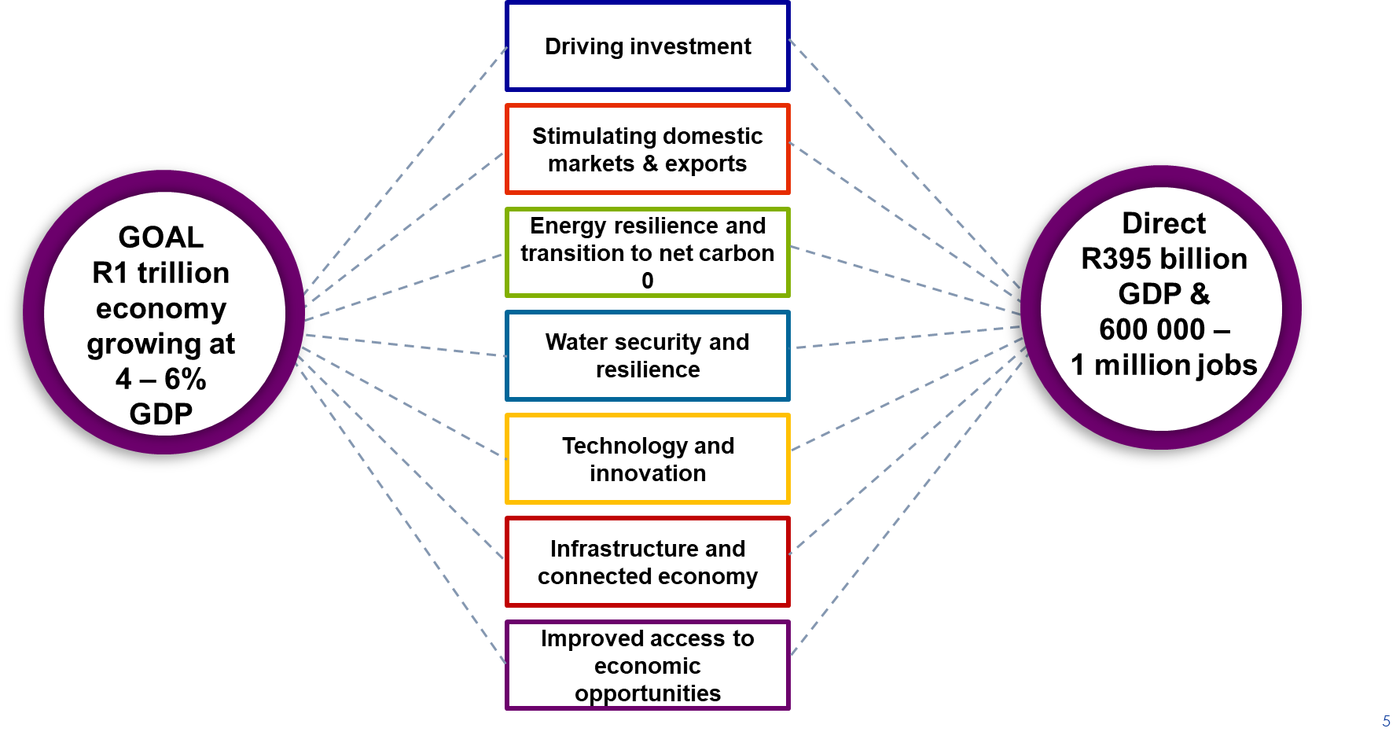
Vision and Goal Statements to address the problem statement
Vision
A provincial economy that achieves break-out economic growth,
resulting sufficient employment and opportunity and an economy that is sustainable, resilient, diverse and thriving – generating confidence, hope and prosperity for all.
Notes:
Vision
A provincial economy that achieves break-out economic growth, resulting sufficient employment and opportunity and an economy that is sustainable, resilient, diverse and thriving – generating confidence, hope and prosperity for all.
Goal
By 2035, the Western Cape will be a R1-trillion inclusive economy in real terms and growing at between 4% and 6% per annum. This will be achieved through enabling a competitive business environment in which growth is driven through businesses exploiting opportunities.
Increasing inclusion
driven by jobs-rich growth in the formal, informal and township sectors, benefitting all citizens, communities and enterprises – both urban and rural – and especially women and young people.
Competitive business environment
that ensures total factor productivity growth through competition, productivity enhancing spatial policies, and investment in infrastructure, connectivity and skills, with government officials who all apply an ease-of-doing-business approach.
Increased sustainability
as the Western Cape Government accelerates progress to a net zero carbon and resilient province, conserves the natural environment and mitigates the impact of climate change.
Resilience
through diversifying economic activity and strengthening the Western Cape Government’s ability to anticipate, prepare for and respond to exogenous shocks, including climate change, migration, adverse political/geopolitical events and the Fourth Industrial Revolution.
Thriving people and places
whose social and economic potential is being realised through improved access to opportunities, and where solutions to challenges build on a diversity of cultures and talents.
Confidence and hope
with businesses and citizens that are positive about their economy and the Western Cape’s future, and a high level of trust among the private sector, communities, residents and government, who work together to address challenges and realise opportunities.
Prosperity
with everyone in the region having an improved quality of life, increased wealth and more opportunities

Slide 5
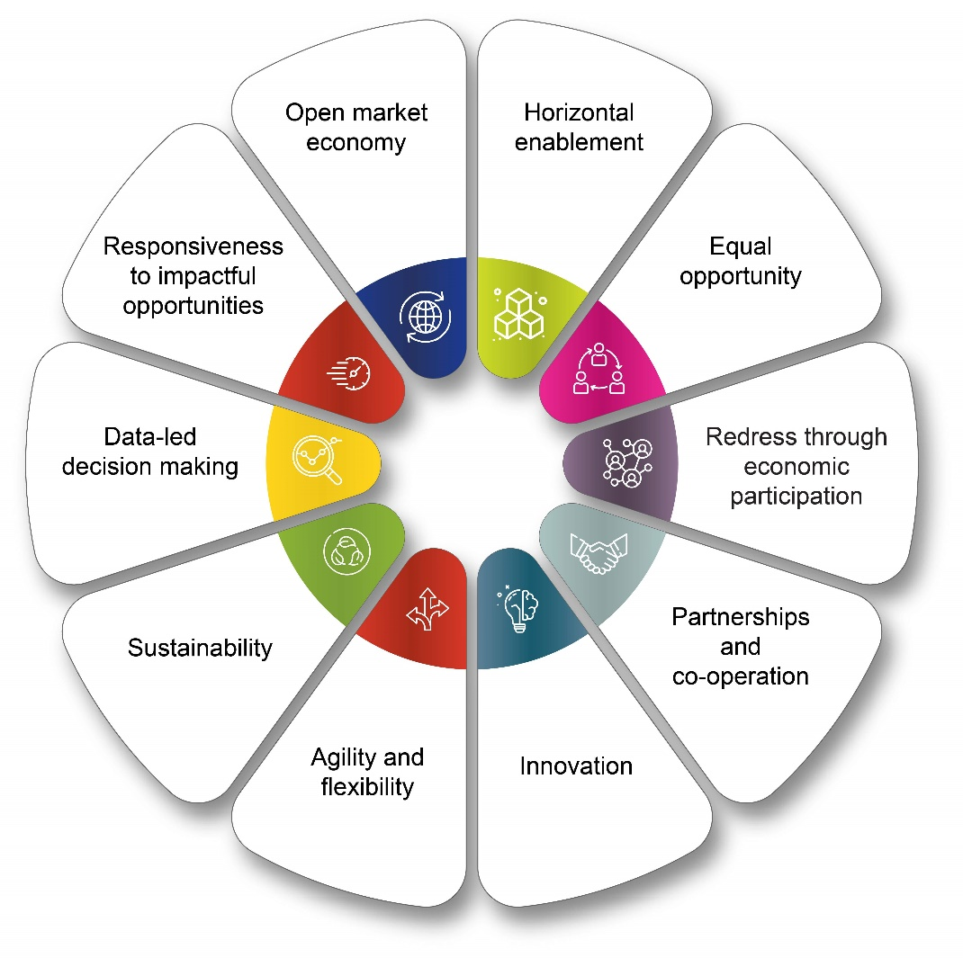
Principles underpinning the Growth for Jobs Strategic Framework
The Growth for Jobs Strategic Framework supports economic growth for job creation that favours…
Notes:
Partnerships and cooperation. Strategic partnerships and cooperation with other spheres of government and the private sector to increase the speed and scale of change.
Innovation. Embracing new ideas and pushing the boundaries of the Western Cape’s constitutional mandate to enable private-sector-led economic growth and job creation in tourism, trade and industrial policy.
Responsiveness to impactful opportunities. Government should be responsive to all private-sector-led opportunities, while being selective about which support levers are deployed based on the extent of private-sector involvement and participation, and evidence of the potential of the opportunity.

Slide 6
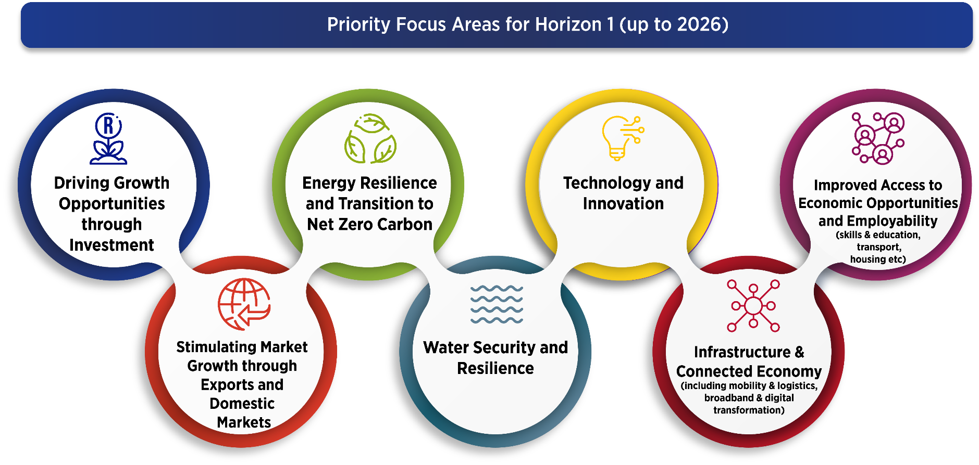
Priority Focus Areas, Levers and Enablers
7 priority focus areas identified for short and medium term based on the need to:
Horizontally enable the economy
Addressing key binding constraints and most pressing issues
Reaching the G4J goals and vision
Notes:
Priority Focus Areas
A process of analysis and engagement led to seven Priority Focus Areas for the Strategy being identified for implementation over the short and medium term. The seven PFAs concentrate on the key constraints in network industries and on the essential elements needed to raise total factor productivity and competitiveness. Over time, these priority areas may change, as the Growth for Jobs Strategy will need to be agile in the face of changing circumstances and opportunities

Slide 7
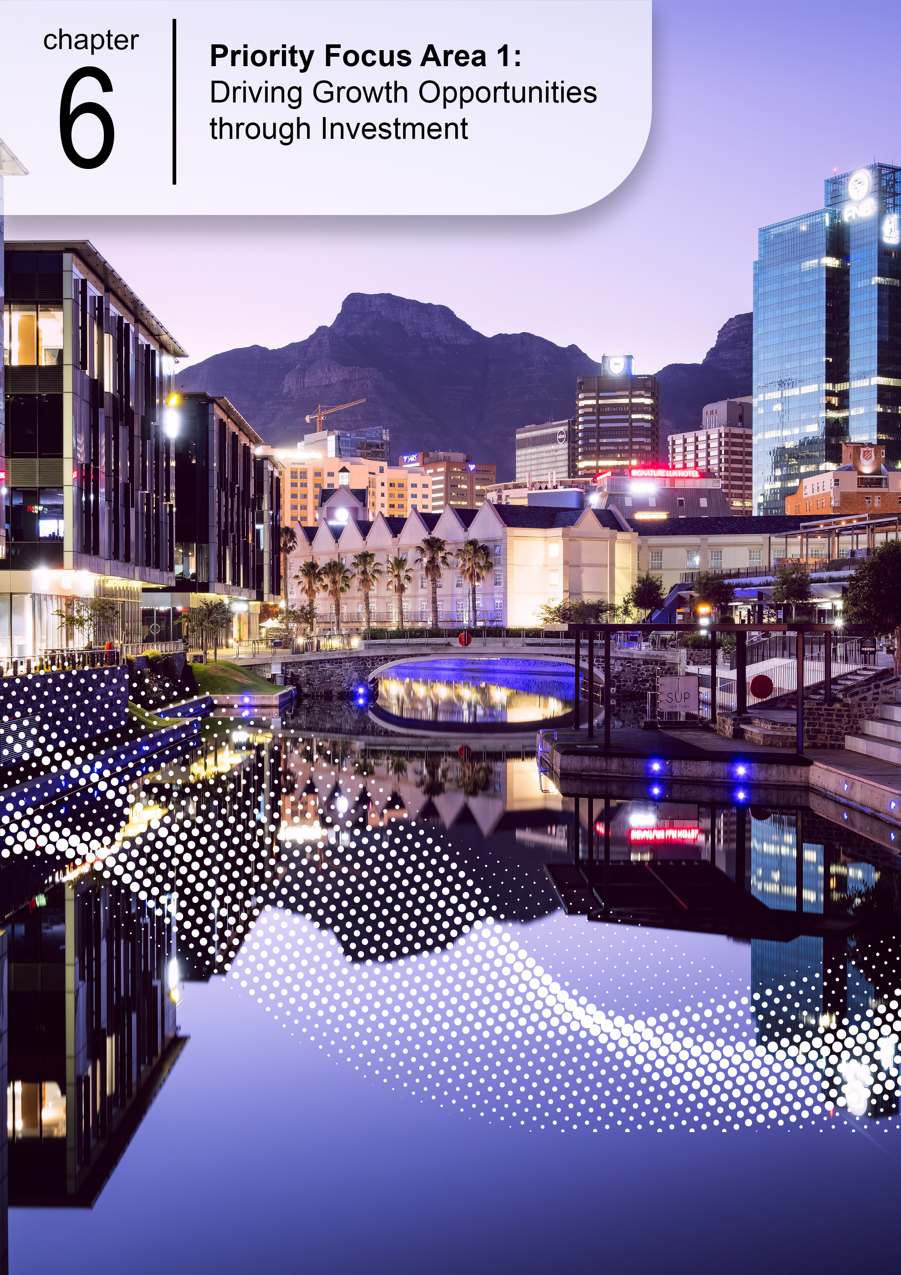
Driving Growth Opportunities through Investment

Slide 8
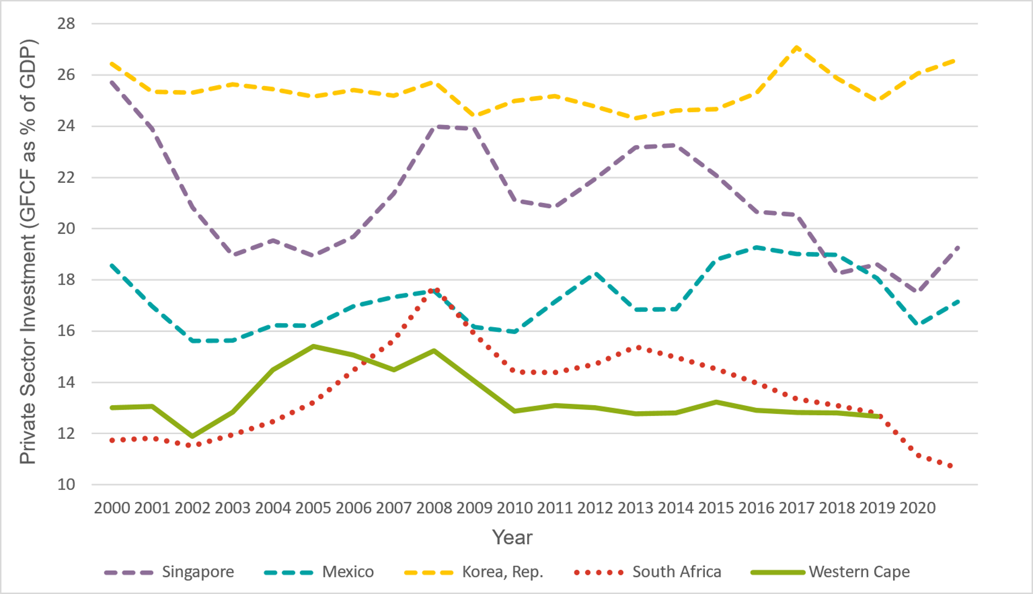
Driving Growth Opportunities through Investment
Goal
Why it matters
Private-sector investment will be 20% of regional GDP (translating to R200-billion) by 2035.
The accumulation of fixed capital raises productivity capacity, increases productivity, and improves business confidence. It is a critical contributor towards GDP growth.
Private-sector investment (GFCF as a percentage of GDP)
Objective
The Western Cape is the investment destination of choice for local and international investors in a range of growth opportunities, providing an enabled environment and strong networks of ecosystems.
Source: World Bank; SARB / Quantec (Western Cape
Notes:
WC GFCF currently 14%. At this rate, compensating for depreciation, every year we have less private sector capital.
A point in case for private sector. A clothing and textile worker with a needle and thread can only produce one jersey per day, one with industria knitting machine can produce 1000 jerseys per day. Who will be paid more. In fact foreign companies will driver out the aunty with knitting needles. This is true for every sector

Slide 9
Driving Growth Opportunities through Investment
1
2
3
Smart investment promotion, facilitation and support
Developing an overall Cape brand, as well as sets of brands, for specific ‘foundation’ and emerging industry and place-based opportunities.
Undertaking aggressive programmes to market and promote the growth opportunities
Strengthening the overall investment facilitation ecosystem
Developing a platform to seamlessly link investors with opportunities
Enabling competitive environment
Addressing visa challenges.
Identifying and addressing the top three investor constraints
Developing nuanced packages of support and incentives (especially non-financial) for individual growth opportunities, and simultaneously address the systemic competitiveness issues.
Ensuring that the necessary infrastructure for investment is provided
Radically increasing supply of affordable housing
Increasing policy and regulatory certainty through engaging with all spheres of government
Strong supportive eco-systems of collaboration, intelligence sharing and trust
Supporting growth opportunity ecosystems
Strengthening the investment and opportunity economic IQ
Notes:
Actions towards 2035 success
Smart investment promotion, facilitation and support
Developing an overall Cape Brand inclusive of industry and place-based opportunities
Undertaking aggressive programmes to market and promote growth opportunities
Strengthening the overall investment facilitation ecosystem
Developing platforms to link investors to opportunities
Enabling and competitive environment
Addressing visa challenges and identifying the top three investor constraints
Developing nuanced packages of support and incentives (especially non-financial)
Ensuring that the necessary infrastructure for investment is provided
Radically increasing supply of affordable housing
Increasing policy and regulatory certainty
Strong and supportive ecosystems of collaboration, intelligence sharing and trust
Supporting growth opportunity ecosystems
Strengthening the investment and opportunity economic intelligence

Slide 10
Priority Focus Area 2: Stimulating Market Growth through Exports and Domestic Markets

Slide 11
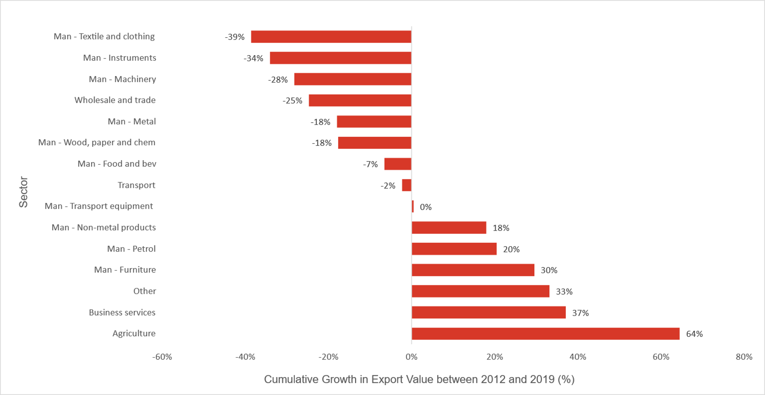
Stimulating Market Growth through Exports and Domestic Markets
Goal
Why it matters
The value of Western Cape exports of goods and services (inclusive of tourism) will triple by 2035.
Exporting allows a country to diversify its production across new products and additional markets, achieve economies of scale and therefore improve productivity and competitiveness, raising overall trade and protecting the country from potential shocks.
Export performance by sector, cumulative growth in export value (2012–2019)
Objective
The Western Cape, with a strong domestic market capability, is a leading global export region in a diversified basket of goods and services and a sought-after tourism destination known for its quality, reliability and cost-effective goods and service offerings.
Source: World Bank,^{[1]} Quantec^{[2]}
Notes:
Business services such as BPO and agri has shown some significant growth in competitiveness. Their export perf is then not surprising. WE need to replicate this in other tradable sectors

Slide 12
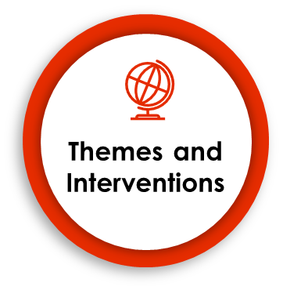
Stimulating Market Growth through Exports and Domestic Markets
1
2
3
Unlocking an enabling and competitive export environment
Improving freight logistics.
Expanding the Air Access Initiative.
Enhancing supportive compliance infrastructure and regulations.
Strengthen and diversify the Western Cape export base
Producing and using economic IQ.
Coordinating and leveraging the activities of other provincial departments.
Enhancing and developing exporter ecosystems.
Developing and implementing export strategies and plans.
Strengthening the export capabilities in identified industries.
Drive market access
Developing and implementing country plans.
Creating an enabling and facilitating environment in target countries.
Identifying and pursuing export opportunities in Africa.
Strengthening intergovernmental coordination and advocacy.
Establishing and promoting a Western Cape brand.
Using technology for enhanced matchmaking.
Leveraging cross-selling opportunities.
Notes:
Actions towards 2035 success
1. Unlocking an enabling and competitive export environment
Improving freight logistics
Expanding Air Access
Enhancing supportive compliance infrastructure and regulations
2. Strengthen and diversify the Western Cape export base
Producing and using economic intelligence
Enhancing and developing exporter ecosystems
Developing and implementing export strategies and plans
Strengthening export capabilities in identified industries
Coordinating and leveraging the activities of other provincial departments
3. Drive market access
Establishing and promoting a Western Cape brand
Developing and implementing country marketing plans
Creating an enabling and facilitating environment in target countries
Identifying and pursuing export opportunities in Africa
Strengthening intergovernmental coordination and advocacy
Using technology for enhanced matchmaking
Leveraging cross-selling opportunities

Slide 13
Priority Focus Area 3: Energy Resilience and Transition to Net Zero Carbon

Slide 14
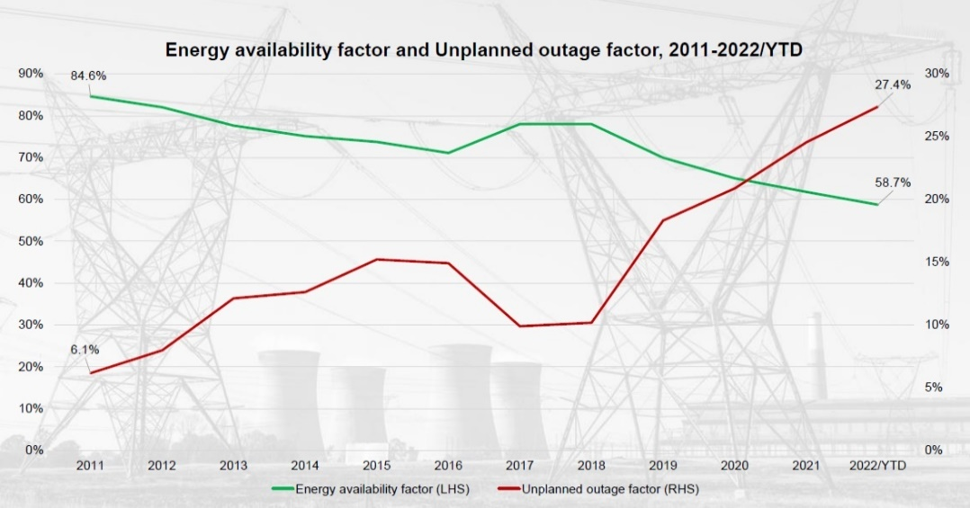
Energy Resilience and Transition to Net Zero Carbon
Goal
Why it matters
Reduce reliance of energy from Eskom of between 1 800 – 5 700 MW by 2035, estimated to attract between R21.6-billion and R68.4-billion in related investment.
Energy security continues to remain the major constraint on growth – Load-shedding established to have reduced real GDP growth by 3% in 2021, resulting in 350000 job losses (CSIR and PWC) .
Energy availability factor and Renewable energy procurement Unplanned outages, 2011 – 2022 Year-To-Date
Objective
Energy is low carbon, reliable, competitive, accessible, enabled supplied at scale, and meets the energy-efficient demands of the economy, using data, analytical tools and new models of delivery and contributing towards net zero carbon targets.
CO2/cap 3rd
CO2/GDP 7th
CO2 total 13th
South Africa’s Global Rankings
Notes:
ENERGY RESILIENCE
… and transitioning towards net zero carbon
Goal Statement
Reduce reliance of energy from Eskom of between 1 800 – 5700 MW by 2035, estimated to attract between R21.6-billion and R68.4-billion in related investment
Objective Statement
Energy is low carbon, reliable, competitive, accessible, enabled and supplied at scale, and meets the energy-efficient demands of the economy, using data, analytical tools and new models of delivery and contributing towards net zero carbon targets
Electricity is currently the number one binding constraint to economic growth and job creation, caused by the 6 GW shortfall in electricity production. Over and above this, South Africa is one of the world’s most carbon-intensive economies, with dire implications for the climate, the environment and the economy. The key energy thrusts that the Growth for Jobs Strategy seeks to address are:
ensuring the availability of affordable, reliable electricity supply
creating an enabling environment for the transition from fossil fuels to renewable sources of energy
leveraging the energy transition as a source of competitive advantage for the Western Cape’s economy
National electricity crisis
The South African economy is 8−10% smaller as a direct consequence of load-shedding. Accessing alternative sources of reliable energy is an economic imperative, as Eskom’s performance is unlikely to improve for the remainder of the decade. The Energy Availability Factor (EAF) will continue to decline primarily due to plant breakdowns and the decommissioning of Eskom coal plants by 2035.
Western Cape has tremendous renewable-energy generation potential
South Africa has extremely good conditions for both wind and solar energy, with South Africa’s Renewable Energy Independent Power Producer (REIPP) already attracting over R200-billion in private-sector investment.
The Western Cape, with its sound infrastructural base and conducive climate, has been the largest provincial beneficiary of FDI in renewable energy projects. Despite rapid growth and the potential to create 1.2 million jobs., renewable energy still represents a small share of the total amount of energy produced in South Africa.
Share of electricity production from renewable sources
The growing dominance of carbon border adjustment (CBA) mechanisms will increase the price of imports from carbon-intensive nations such as South Africa. The impacts of climate change demand a response and the Western Cape Government has committed to net zero greenhouse gas (GHG) emissions by the year 2050.
There is no simple solution to the energy crisis in South Africa. A total overhaul of the power sector, including increasing diversification and decentralisation of the energy supply is required

Slide 15
Energy Resilience themes and interventions
1
4
5
Disaster mitigation and management
Strengthening and coordinating the disaster mitigation and management system
Generation, procurement and trading
of low-carbon energy
Streamlining processes for SSEG registration and creating an enabling & cost-effective wheeling framework
Testing of individual municipal IPP procurement projects while working on establishing and operationalising an energy trading system/pooled buying mechanism
Making government land available for utility-scale energy generation and energy storage
Developing a digital platform for sharing energy data and enabling transactions
Considering the adoption of natural gas alternatives
Providing alternative energy support for SMMEs
Implementing renewable energy solutions in municipalities
Implementing a programme for Solar PV in schools and WCG buildings / facilities
Maintenance and expansion of
required energy infrastructure
Mapping out infrastructure requirements, including scaled penetration of renewable energies
Protecting energy infrastructure from vandalism and theft.
Planning and implementing the required upgraded transmission and distribution infrastructure.
2
Energy efficiency at scale
(demand management)
Conducting provincial energy efficiency surveys.
Developing a provincial energy efficiency programme
6
Increased investment in the energy sector
Developing a Western Cape Just Energy Transition (JET) Investment Plan
Establish a project preparation facility to take identified projects to bankability.
Planning and forming partnerships to enable green hydrogen production at scale
Planning for electric vehicles
Working with liquid fuels companies to encourage biofuel blending
Encouraging local production of key renewable energy components and/or systems
3
Strategic development and management
Developing a Western Cape Integrated Resource Plan
Developing strong partnerships and a strengthened ecosystem with energy stakeholders, including economic IQ capabilities
Notes:
Actions towards 2035 success
1. Disaster mitigation and management (load-shedding impact reduction)
Strengthening and co-ordinating the disaster mitigation and management system
2. Energy efficiency at scale (demand management)
Conducting provincial energy efficiency surveys and developing energy efficiency programmes
3. Generation, procurement, and trading of low carbon energy
Streamlining processes for SSEG and wheeling, potentially creating a virtual power station
Testing of individual municipal IPP procurement projects and implementing renewable energy solutions in municipalities
Making government land available for energy generation
Considering the adoption of natural gas alternatives
Providing alternative energy support for SMMEs
Implementing a programme for Solar PV in schools and Western Cape Government buildings/facilities
Stimulating the green energy market by developing a digital platform
4. Increased investment in the energy sector
Developing a Western Cape Just Energy Transition (JET) Investment Plan
Establishing a project preparation facility to take identified projects to bankability
Planning and forming partnerships to enable green hydrogen production
Planning for an enabling environment for electric vehicles
Working with liquid fuels companies to encourage biofuel blending
Encouraging local production of key renewable energy components
5. Increased investment in the energy sector
Developing a Western Cape Integrated Resource Plan
Developing strong partnerships and a strengthened ecosystem and resourcing economic intelligence capabilities

Slide 16
Priority Focus Area 4: Water Security and Resilience

Slide 17
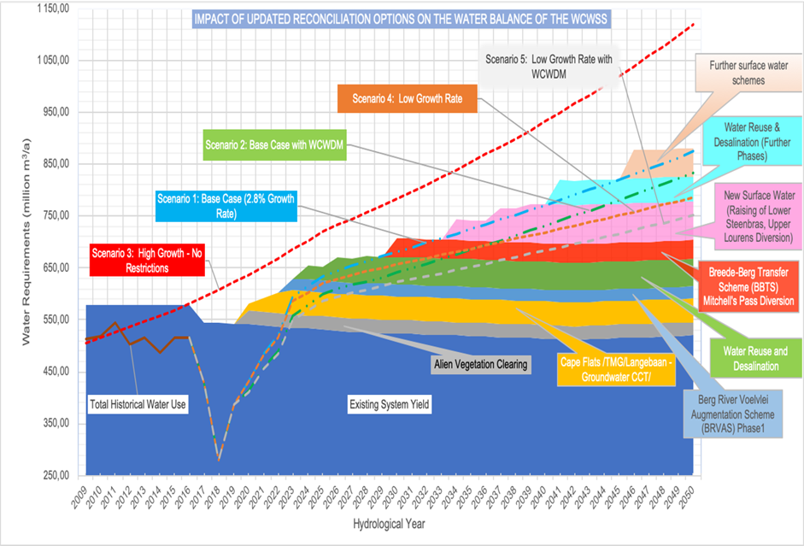
Water Security and Resilience
Goal
Why it matters
Addressing water security will give investors confidence – in water availability and in government
Double the amount of water available for secondary and tertiary economic sectors (primarily from non-productive use) by 2035 and honour existing allocations to agriculture.
Objective
The province will have optimised and increased its water supply, integrated the management of water resources, and enhanced the adaptive capacity of business and citizens with respect to water usage to improve resilience, competitiveness, and quality of life for all its people, so that it has a sufficient water supply to achieve its economic growth aspirations.
Notes:
Goal Statement
Double the amount of water available for secondary and tertiary economic sectors (primarily from non-productive use) by 2035 and honour existing allocations to agriculture.
Objective Statement
The province will have optimised and increased water supply, integrated the management of water resources, and enhanced the adaptive capacity of business and citizens with respect to water usage to improve resilience, competitiveness, and quality of life for all its people, so that it has sufficient water supply to achieve its economic growth aspirations.
As populations and economies grow, the need for water increases. Indeed, given the importance of water to all production processes. Constraints in water provision translate directly into slower economic growth and reduced economic opportunities. The Western Cape’s experience with severe drought illustrated the impact that poor water security has on citizens and the economy. The key challenges facing the province are the distribution, management, and availability of water, with climate change deepening these challenges.
Changing our relationship with water
Despite being among the top 30 most water-stressed countries in the world (ranked 29), South Africa consumes about 233 litres per person/day compared to the international benchmark of 180 litres per person/day.
Although the Western Cape has limited control over its global impacts, climate change can serve as a driver for proactive investment in climate adaptation. If the Western Cape were to become a national leader in water and climate resilience, by 2040, the province’s economy would grow by up to 15%, with a commensurate 12.4% increase in jobs and the overall cost of living would decrease..
The Western Cape Water Supply System (WCWSS) consists of six dams, pump stations, pipelines, and tunnels. The WCWSS water demand modelling undertaken by the DWS indicates five demand growth scenarios and the committed supply interventions. (See scenarios below).
The provincial Economic Water Resilience Strategic Framework maps out the various steps to support business in reducing overall water consumption and use, through audits, targets and risks, water efficiency interventions, onsite re-use of water and alternative water supply. Guided by the strategic framework, the 2021
Western Cape Water Resilience Plan, which comprises a set of inter-disciplinary and comprehensive reports, provides the most recent situation analysis and guides all economic water resilience interventions.

Slide 18
Water Security and Resilience themes and interventions
1
2
Supply side management
Conducting a study of the water supply value chain
Optimising water supply at source
Reviewing and revising municipal water bylaws
Monitoring groundwater quality and abstraction levels, to ensure adequate aquifer recharge.
Infrastructure Maintenance
Expanding ‘smart’ water systems for monitoring of water usage and data collection
Improving supply-chain management processes
Prioritising the maintenance of the waterways and canals
3
Demand side management
Collecting accurate, real-time data and intelligence on water usage
Developing, resourcing, and implementing a sustained provincial economic water resilience programme
Targeting industrial areas to implement water re-use strategies.
Developing a behavioural change programme to foster a culture of valuing and conserving water
Identifying and addressing regulatory challenges that impede water system efficiencies
Incorporating water sensitive design into urban development
5
4
Alternative water costing models for municipalities
De-coupling water service charges from sanitation charges to encourage grey water reticulation.
Innovating around a shift in the municipal revenue model
Exploring risk-sharing and co-financing arrangements with innovative funding models and revenue systems.
Coordinated water infrastructure oversight and investment
Undertaking appropriate and coordinated water governance planning (including forecasting)
Collaborating on water infrastructure investment
Providing clear policies to businesses with respect to decentralised systems
Funding regional water innovation hubs
Notes:
Actions towards 2035 success
1. Supply-side management
Conducting a study of the water supply value chain
Optimising water supply at source
Reviewing and revising municipal water bylaws
Monitoring groundwater quality
2. Infrastructure maintenance
Expanding ‘smart’ water systems
Developing a provincial energy efficiency programme
Improving supply-chain management processes
Prioritising the maintenance of the waterways and canals
3. Demand-side management
Collecting accurate, real-time data and intelligence
Developing, resourcing, and implementing a sustained provincial economic water resilience programme
Targeting industrial areas
Developing a behavioural change programme
Identifying and addressing regulatory challenges
Incorporating water sensitive design
4. Coordinated water infrastructure oversight and investment
Undertaking appropriate and coordinated water governance planning
Collaborating and coordinating with respect to water infrastructure investment
Providing clear policies to businesses
Funding regional water innovation hubs
5. Alternative water costing models for municipalities
De-coupling water service charges from sanitation charges
Innovating around a shift in the municipal revenue model
Exploring risk-sharing and co-financing arrangements

Slide 19
Priority Focus Area 5: Technology and Innovation

Slide 20
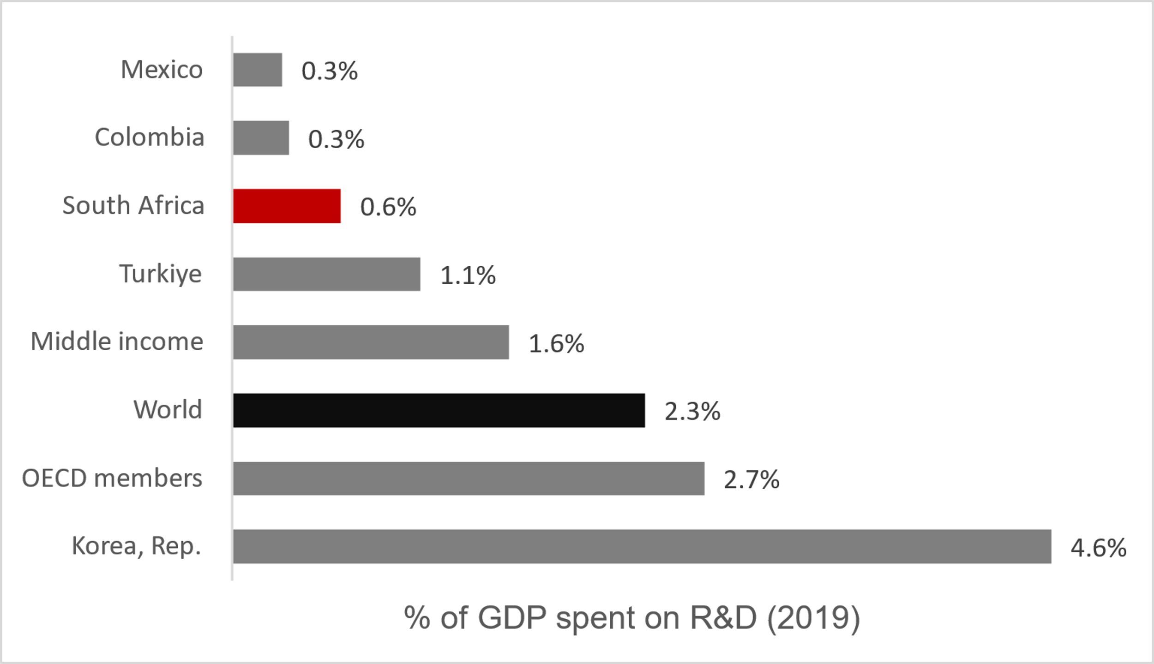
Technology and Innovation
Goal
Why it matters
Technological innovation is responsible for 85% of growth (OECD, 2004) and it is a key driver of increased Total Factor Productivity growth and thereby long-term economic growth.
By 2035, research and development expenditure will increase by 300% in real terms, reaching R35-billion and venture capital deals will total R20-billion.
Share of GDP spent on R&D (2019)
Objective
The Western Cape is the tech, start-up and venture capital and innovation and design capital of Africa, through robust business, government and community innovation (supported by academia), with strong technology ecosystems and centres of excellence in a range of industries and opportunities, with a supportive enabling environment and where the adoption of appropriate technology and accessible innovation leads to an improvement in the Global Innovation Index and the productivity and competitiveness of the regional economy.
Notes:
Partnering for TECHNOLOGY AND INNOVATION
Goal Statement
By 2035, research and development expenditure will increase by 300% in real terms, reaching R35-billion and venture capital deals will total R20-billion
Objective Statement
The Western Cape is the tech, start-up and venture capital and innovation and design capital of Africa, through robust business, government and community innovation (supported by academia), with strong technology ecosystems and centres of excellence in a range of industries and opportunities, with a supportive enabling environment, and where the adoption of appropriate technology and accessible innovation leads to an improvement in the Global Innovation Index and the productivity and competitiveness of the regional economy.
Changes in technology are the only source of permanent increases in productivity, while R&D investment causes 50% of output growth and 75% of productivity growth.
Technologically and innovatively driven firms drive economy-wide productivity gains through resource efficiency. Innovative firms use cooperation with higher education institutions to commercialise R&D and spur new economic activity. The strength and depth of these processes are crucial for a region’s competitiveness.
South Africa needs expand innovation and Research and Development
The gulf between the country’s R&D targets and its performance is stark and widening, with expenditure just 62% of the targeted 1.1% of GDP. If the target of 1.1% of GDP is met, this could translate into R54-billion growth by 2024. Furthermore, the private sector should ideally contribute over 50% of gross expenditure on R&D but only contributed 31% in 2019. At the same time, the Western Cape has growing tech and start-up enterprises that can be further expanded with a greater focus on enabling R&D.
“…in 2019, the gross tertiary enrolment rate was 53.8% in China, 55.1% in Brazil, 42.8% in Mexico but just 23.9% in South Africa”.
Higher education institutions are key actors in the regional innovation system. Knowledge can be transferred to local businesses, or start-ups can be created. Despite being home to world-class innovations, in 2020, the country had 25 patent applications per million population, compared to the average of 641 for upper middle-income countries. South Africa has the potential and talent for further ground-breaking R&D that can be commercialised, but this needs to be unlocked by additional and more synchronised investment.
Firms need to adopt technology and innovation
In 2020, 70% of South African firms in manufacturing and services used email for conducting business, while only 36% of firms had websites. The implication is that South African businesses are not fully utilising the productivity and competitiveness improvements offered by technology.
The Western Cape must embrace the opportunities as Africa’s innovation and tech hub
The overall value of the digital economy ranges between 4.5% and 22.5% of global GDP, depending on which definitions and measures are used. According to the definition used by the World Bank, the size of the global digital economy is expected to be the fastest-growing component of most economies.. In 2020, South Africa’s ‘internet economy’ was valued at $21.55-billion, or about 6.51% of GDP, and is expected to grow to more than $125-billion, or 12.92% of GDP by 2050.
The Western Cape is South Africa’s key node of this growth, being the home to 39 tech ecosystem accelerators. These high performing hubs has attracted the highest number of venture capital firms in Africa and, in 2020, a total of $88-million was invested into tech start-ups in Cape Town.
Innovation can be understood as “the multi-stage process whereby organisations transform ideas into new/improved products, service or processes, in order to compete and differentiate themselves successfully in their marketplace”. Technology, inclusive of digital technology, is the creation, usage and knowledge of tools, techniques, crafts, systems or methods to solve a problem or serve a purpose or end. Innovation and technology are therefore not synonymous but are inter-related in that technology is often a driver and enabler of the proliferation and evolution of innovation.

Slide 21
Technology and Innovation themes and interventions
1
4
Strengthen ease of doing business and promote eco-systems of technology and innovation
Addressing regulatory and legal reform
Building and supporting networks in the technology and innovation ecosystems
Establishing a sandbox for emerging technologies and innovation
Investigating the establishment of a challenge fund to stimulate collaboration in R&D and innovation
Strengthening the catalytic role of universities in the economy
Developing a single, comprehensive entrepreneurial/innovation portal that addresses the market need
Supporting human capital development
Introducing practical postgraduate ICT and tech conversion programmes
Strengthening the digital skills foundation at school level
Using the Western Cape assets for digital education, skills development and for accessing the digital economy
Assisting the WCED to adapt the education system, to increase the focus on innovation and creativity
Targeting specialist skills programmes for sector-specific skills-sets and developing capabilities in key growth sectors.
Building and strengthening public service innovation capabilities
Themes & interventions
2
3
Stimulating growth of and demand of innovation and technology start-ups and scale ups
Positioning and marketing the Western Cape as Africa’s hub of venture capital, digital, tech, innovation and start-ups.
Promoting the uptake of technology and innovation within the private sector.
Driving the Western Cape Government to be more outward-facing with respect to innovation
Establishing a regulatory sandbox for government
Establish the Western Cape as a venture capital hub for start-ups and scale ups
Improving ease of doing business with respect to funding and venture capital accessibility
Investigating how incentives or creating a physical hub can attract investment in digital, technology and innovation start-ups.
Facilitating the growth of venture capital funds
Providing support particularly for growth-orientated business to access and maximise national incentive programmes with respect to R&D and innovation.
Notes:
Actions towards 2035 success
1. Strengthen ease of doing business and promote ecosystems of technology and innovation
Addressing regulatory and legal reform
Building and supporting networks in the technology and innovation ecosystems
Establishing a sandbox for emerging technologies and innovation
Investigating the establishment of a challenge fund
Strengthening the catalytic role of universities and support for research chairs at universities
Developing a single, comprehensive entrepreneurial/innovation portal
2. Establish the Western Cape as a venture capital hub for start-ups and scale-ups
Improving ease of doing business, including exchange control and intellectual property
Investigating incentives to attract and support start-ups and growth-orientated business
Facilitating the growth of venture capital funds
Strengthening the finance and funding ecosystem
3. Stimulate growth of and demand for innovation and technology start-ups and scale-ups
Positioning and marketing the Western Cape as Africa’s hub of venture capital, digital, tech, innovation and start-ups
Promoting the uptake of technology and innovation within industries and verticals
Enabling SMMEs to take up technology
Driving the Western Cape Government to be more outward-facing in terms of innovation
4. Supporting human capital development
Introducing practical postgraduate ICT and tech conversion programmes
Strengthening the digital skills foundation at school level and adapting the education system
Economic growth requires economic infrastructure, which supports productive activities and social infrastructure, which enables the functionality of communities. While all infrastructure is prioritised, particular attention is needed on infrastructure for connectivity, which includes both the movement of goods and people and digital connectivity.

Slide 22
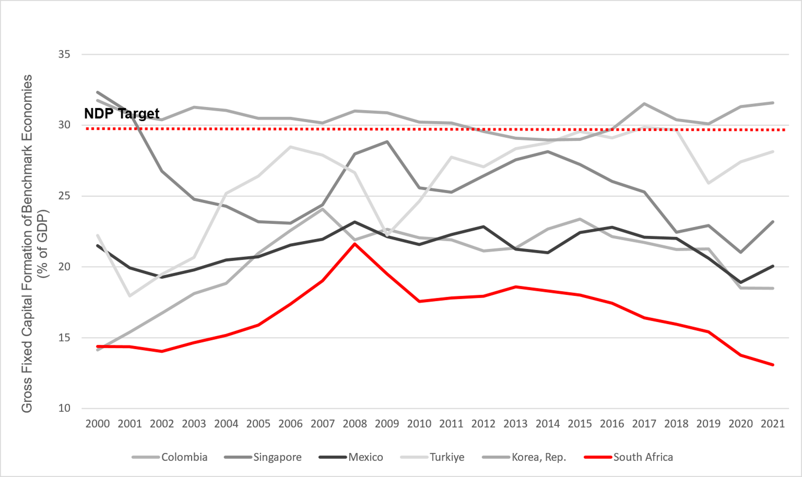
Infrastructure and Connected Economy
Goal
Why it matters
The Western Cape economy will have the infrastructure required to support and enable a R1 trillion economy by 2035 and public sector capital investment in the Western Cape will be 10% of regional GDP.
Well-developed infrastructure is key requirement for a competitive economy bringing multiple benefits and avoids costs and 1% increase in infrastructure quality increases competitiveness by 0,64%
Objective
GFCF comparison with NDP target and other countries
To coordinate, prioritise, plan and implement the timeous delivery of relevant and smart infrastructural solutions (physical, digital and hybrid) to support break-out economic growth and a connected economy, providing flexible, resilient infrastructure that intelligently connects spaces, places, and people, transforms lives and delivers sustainable value to the economy and ecology of the Western Cape.
Notes:
Connecting through INFRASTRUCTURE and DIGITALISATION
Goal Statement
By 2035, the Western Cape economy will have the infrastructure required to support and enable a R1-trillion economy and public sector capital investment in the Western Cape will be 10% of regional GDP.
Objective Statement
To coordinate, prioritise, plan, and implement the timeous delivery of relevant and smart infrastructural solutions (physical, digital and hybrid) to support break-out economic growth and a connected economy, providing flexible, resilient infrastructure that intelligently connects spaces, places, and people, transforms lives and delivers sustainable value to the economy of the Western Cape.
Economic infrastructure has deteriorated nationally due to underinvestment
Economic infrastructure – under direct control of national departments and SOEs – represents the most immediate and binding constraint on provincial economic growth prospects.
Public-sector investment needs to enable growth
Public sector infrastructure investment sits at 4.1% of GDP (2022), - against a target of 10%. It is estimated that one-third of infrastructure expenditure is lost as a result of inefficiency due to governance-related challenges. State Owneed Entities have struggled to allocate and deliver infrastructure efficiently and effectively, undermining the country’s macroeconomic stability. Municipalities have also continuously underspent on conditional grants and increasingly, have not collected sufficient revenue to finance capital infrastructure. The impact of the expenditure decline and inefficiencies is reflected in the 2022 SAICE Report, where South Africa’s public infrastructure received a ‘D’, signifying that overall it is at risk of failure, although the grades vary across sectors.
Provincial infrastructure landscape
Western Cape Government is directly responsible for about one-third of the overall capital budget, with the City of Cape Town’s capital budget contributing 40% towards the total spend. The remaining budget is split between the tertiary education sector and other municipalities.
Infrastructure needs to enable economic growth
The Growth for Jobs Strategy will shape the Western Cape Infrastructure Plan 2050 (WCIP 2050), which will complement the City of Cape Town’s Infrastructure Delivery Plan as well as plans of other municipalities. The Plan will include an emphasis, amongst others, on connectivity and the network industries:
Ports: The importance of the port sector to the Western Cape economy cannot be overestimated. Over half (52%) of Western Cape exports (valued at R86-billion) were exported via the port of Cape Town. A high-growth scenario would result in another R6-billion in exports and about 20 000 more direct and indirect jobs at the port by 2026. Port expansion is required in Cape Town and Saldanha in response to local and international markets and as economic catalysts – but equally there are low-hanging fruit such as solving land-side transport bottlenecks to allow the better flow of goods, and better planning and tracking.
Rail network: The Western Cape rail network consists of 4994 km of Transnet and 610 km of Passenger Rail Agency of South Africa (PRASA) railway lines. Vandalism of the rail system has resulted in half the trainsets being lost and approximately 400 000 passengers moving away from using rail services to passenger vehicles, resulting in high traffic volumes and increased fuel use and vehicle emissions. Rail infrastructure has suffered heavily from historical underinvestment, and the rehabilitation and upgrading of existing passenger and freight rail systems is a priority. An end-to-end view of logistics is the opportunity that needs to be grasped.
Airports: Demand-led expansion plans for Cape Town International Airport, which had been deferred in part because of Covid-19, need to be revived in line with the revived increase in cargo and passenger flows.
Digital connectivity. Provincially, access to mobile communication has increased dramatically whereas internet access has been stagnant. .The foundational role of digital transformation means that the benefits of becoming a fully digitally enabled society and economy outweigh the costs.
Three factors that influence the delivery and condition of infrastructure are people and relationships, institutional robustness, and data and information. The Western Cape’s economy depends on effective and efficient transport networks and services for the movement of people and goods, and, these three factors have to be addressed along with the necessary planning and financing.

Slide 23
Priority Focus Area 6: Infrastructure and Connected Economy (mobility, logistics, broadband and digital transformation)

Slide 24
Infrastructure and Connected Economy Themes and Interventions
1
2
3
Coordinated planning
and strengthened ecosystem
Developing a Western Cape infrastructure framework incorporating 50% economic growth of the economy by 2035
Better aligning planning units of economic cluster departments, municipalities and infrastructure implementors, and establishing a provincial multi-sectoral infrastructure planning and coordination committee or commission
Establishing a well-capacitated data management and infrastructure monitoring system and economic intelligence capability (economic IQ)
Strengthening the ecosystems between government and the private sector along and across various infrastructure verticals or themes
Ease-of-doing government
for accelerated delivery and
management of infrastructure
Overcoming PFMA and MFMA constraints and developing bespoke governance and supply-chain management (SCM) models
Developing an AI and predictive analytics enabled technology platform to model the optimal supply and demand for infrastructure
Reviewing infrastructure-related legislation and regulations (including international benchmarking) with the aim of providing evidence-based advocacy for legislative and regulatory change, including a regulatory sandbox
Building the capacity and capability of municipal officials, including systemic solutions
Infrastructure as a catalyst for targeted economic growth opportunities
Identifying private-sector and community-led models for business infrastructure which includes initiating pilot t township initiatives, exploring high street models, & address the lack of tenure and title deeds
Identifying under-utilised WCG buildings and land that can be for targeted growth opportunities.
Strengthening apprenticeships and semi-skills through expanding contracted in-house capacity
Supporting and strengthening approaches to urban planning, design and development
Driving spatial transformation through enabling and fast-tracking housing development for mixed use and mixed income
4
5
Harness the opportunities in digital and hybrid infrastructure
Rolling out the next phase of the Western Cape Government’s broadband programme
Addressing ease-of-doing business with respect to access to way leaves
Accelerating the rollout of Digital Access Centres.
Providing laptops to all Grade 8s in two rural towns as a pilot project
Driving business and citizen uptake through the digitisation of government services and procurement processes
Making government data open and accessible to businesses and academia.
Logistics & mobility
Championing catalytic logistics initiatives that stimulate economic growth, deliver infrastructure solutions and positively impact spatial patterns
Working collaboratively with Transnet and partners to address the current challenges at the Cape Town port/container terminal.
Explore, among others, the introduction of a cashless payment system to be used in taxis and buses to promote productivity
Seeking devolution of the PRASA Metrorail function and the development of PPP concession approaches to public transport development
Introducing new mobility solutions and/or positively impacting spatial patterns
Notes:
Actions towards 2035 success
1. Coordinated planning and strengthened ecosystem
Developing a Western Cape infrastructure framework incorporating 50% economic growth of the economy by 2035
Better aligning provincial multi-sectoral infrastructure planning
Establishing a well-capacitated data management and infrastructure monitoring system and economic intelligence capability
Strengthening the ecosystems between government and the private sector
2. Ease-of-doing government for accelerated delivery and management of infrastructure
Overcoming PFMA and MFMA constraints
Developing an AI and predictive analytics enabled technology platform for demand modelling
Reviewing infrastructure-related legislation and regulations to provide evidence-based advocacy for legislative and regulatory change,
Building the capacity and capability of municipal officials
3. Infrastructure as a catalyst for targeted economic growth opportunities
Driving spatial transformation and economic accessibility and initiating one or two pilot project township initiatives and exploring the development of high street or hybrid models
Addressing the lack of tenure and title deeds
Identifying under-utilised Western Cape Government buildings and land that can be deployed as an accelerator
Strengthening the regional pipeline of apprenticeships and semi-skilled labour
Supporting and strengthening approaches to urban planning, design and development
Driving spatial transformation through enabling and fast-tracking housing development for mixed use and mixed income
4. Harness the opportunities in digital and hybrid infrastructure
Rolling out the next phase of the Western Cape Government’s broadband programme
Addressing ease-of-doing business with respect to access to way leaves
Accelerating the rollout of Digital Access Centres
Providing laptops to all Grade 8s in two rural towns as a pilot
Driving business and citizen uptake through the digitisation of government services and procurement processes
Making government data open and accessible to businesses and academia.
5. Harness the opportunities in digital and hybrid infrastructure
Championing catalytic logistics initiatives
Working collaboratively with Transnet and partners to address the current challenges at the Cape Town port/container terminal
Establishing a task team to explore, among others, the introduction of a cashless payment system to be used in taxis and buses
Seeking devolution of the PRASA Metrorail function
Introducing new mobility solutions and/or positively impacting spatial patterns to reduce time spent commuting

Slide 25
Priority Focus Area 7: Improved Access to Economic Opportunities and Employability (skills and education, transport, housing, etc.)

Slide 26
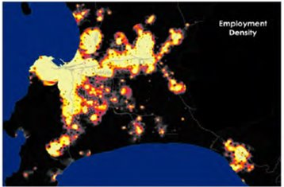
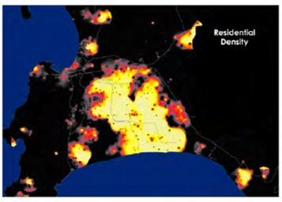
Improved Access to Economic Opportunities and Employability
Goal
Why it matters
All citizens who want to be economically active have improved access to economic opportunities and employability through at least one pathway, with pathways comprising improved employability assets (knowledge, skills, experience, and/or competencies), career management skills, workplace-ready capabilities and skills, economic opportunities more accessible to communities, and entrepreneurship.
891 000 people are unemployed in the WC, equating to an unemployment rate of 27.2% and 32.6% for youth
For every aspirant job seeker in the Western Cape, there are 2.3 residents of working age who have permanently disengaged from the world of work
Actual and budgeted national GFCF as % of GDP
Objective
A thriving society where capable, economically active citizens are able to access economic opportunities and employment, including the skills of the future, and where barriers to accessing information, to developing competencies and skills, and to finding work, have been reduced or removed.
Notes:
Improving pathways for learners, entrepreneurs and aspirant job seekers
Goal Statement
All citizens who want to be economically active have improved access to economic opportunities and employability through at least one pathway, with pathways comprising improved employability assets (knowledge, skills, experience, and/or competencies), career management skills, workplace-ready capabilities and skills, economic opportunities more accessible to communities, and entrepreneurship.
Objective Statement
A thriving society where capable, economically active citizens are able to access economic opportunities and employment, including the skills of the future, and where barriers to accessing information, to developing competencies and skills, and to finding work have been reduced or removed.
Human capital development is at the core of growth strategies. Low-income households face time, distance and cost burdens that reduce access to economic opportunities. The Western Cape Government seeks to enable people to access opportunities through developing skills and productivity, nurturing local expertise and entrepreneurship, enabling micro- and small-sized enterprises to participate in industry value chains, and supporting self-employment.
In a country that has one of the highest levels of unemployment in the world, improving access to economic opportunities and employability is crucial. For the individual, employability depends on four elements:
human capital assets (knowledge, skills, experience, attitudes)
deployment (career management skills)
presentation (job acquisition skills, CV, interview techniques, etc.)
personal circumstances (who you are, who you know, where you live, responsibility, labour market, etc.).
To these, might be added the skills, know-how and resources needed to exploit opportunities for entrepreneurship, be it within a formal or informal business.
South Africa’s labour market: a familiar and wicked problem
The structure of the Western Cape’s labour market closely resembles that of South Africa. With a formal economy that is being held back by a critical shortage of skilled workers, and yet 2.6 million working-age residents are not in gainful employment.
Critical shortage of skilled workers stifling growth
The structure of the Western Cape’s labour market resembles that of South Africa. With a formal economy that is being held back by a critical shortage of skilled workers, and yet 2.6 million working-age residents are not in gainful employment.
South Africa’s economic growth is constrained in part by shortages of skilled labour. Whereas unemployment levels among citizens with advanced qualifications are broadly in line with benchmark economies, unemployment amongst unskilled and semi-skilled job seekers is exceptionally high.
Enabling growth-oriented entrepreneurs
Compared to benchmark economies, South Africans appear to be exceptionally dependent on salaried positions and not particularly successful at self-employment, whether formal or informal.
In South Africa, the informal sector’s contribution to economic activity or employment is small compared to benchmark and even developed country economies, pointing to the need to address. the binding constraints inhibiting the success of growth-oriented entrepreneurs and the improved sustainability of survivalist micro-businesses. Growth-oriented entrepreneurs are key to creating economic opportunities and employment. The binary distinction between formal and informal business inhibits the identification of high potential sectors and nodes.
Preparing learners for the workplace
The Western Cape spends 36% of its budget on education, but weak labour market outcomes suggest a need to align education/skills provided with the needs of employers, especially around jobs for the future.
The WCED curriculum and learning needs to link education to employment more effectively. The knowledge, skills, and abilities that enable people to find or keep a job or advance in the workforce are known as workforce preparation skills. , while more accessible support is required to guide learners and job-seekers towards the skills that the economy requires.
Addressing binding spatial constraints impeding entrepreneurship
To thrive, township economic development depends firstly on the capabilities and resilience of township business and an enabling regulatory environment, and secondly on a spatial environment conducive for businesses to flourish and connect. In townships, the material welfare of local households is constrained by declining levels of inward private investment and insufficient levels of bottom-up business establishment and growth.
The spatial factors driving poor labour market outcomes
Figure : Cape Metro employment density compared to residential density
Source: City of Cape Town
As reflected in the City of Cape Town’s residential area and employment density heat maps for Cape Town (Figure 17), the distances between where Low-income households live and work are significant, imposing time and out-of-pocket costs that can amount to a large portion of poor households’ income, while increasing exposure to crime. face time, distance and cost burdens that reduce access to economic opportunities. These burdens also lower growth because households are unable to accumulate land and human capital.

Slide 27
Improved Access to Economic Opportunities and Employability Themes & Interventions
1
2
Improved education-based and
competency-based pathways
Improving life orientation content on careers, work-readiness and competencies
Expanding after-school programme to develop competencies
Revising curriculum and modes of learning to maximise relevance to the workplace
Accelerating the roll-out of focus schools and increase scale and geographic coverage of these schools
In partnership with the private sector, rolling out an online blended school
Improved post-school
and tertiary education partners
Investigating the feasibility and develop a strategy to expand the number of universities (private sector and public sector) and Technical Vocational Education and Training (TVET) colleges in the Western Cape
Together with the tertiary institutions, enhancing the through-put rates of enrolled tertiary students
4
Bringing economic pathways and opportunities closer to citizens and communities and visa versa
Overcoming the digital divide by making devices, connectivity, and relevant learning content available and accessible to all learners
Creating mixed-use, high density and compact settlements
Developing a vibrant, functional housing market as well as a land assembly pipeline to promote affordable, better located, more integrated housing opportunities and access to housing ladder
Work with municipalities to support homeowner-driven small scale development
Improving public transport to reduce commuting times
Developing an overall Western Cape township strategy as well as township action plans within targeted communities
Considering whether programmes such as the WCG’s Year Beyond Programme and EPWP can be used to assist skills transfer into township-based growth opportunities
Improving urban management in townships to support investment, enabling the development of economic nodes and commercial activities
3
Improved work-place skills and productivity
pathways
Developing initiatives to enhance experiential learning, as well as knowledge exchange
Exploring how the DEDAT’s BPO work placement model can be replicated for growth opportunities
Developing innovative models for micro-certification of modules from credible tertiary institutions rather than long-term accredited skills programmes.
Working with the private sector re their hiring practices
Strengthening dialogue between SMMEs and SETAs to increase funding to non-corporate businesses
Forging closer relationships with the Presidential Employment Stimulus team and YES initiative to better leverage and reorientate these support packages
Championing and investing in programmes to deliver digital skills relevant to the workplace at scale (see Tech and Innovation PFA).
Notes:
Actions towards 2035 success
1. Improved education-based and competency-based pathways
Improving life orientation content on careers, work-readiness, and competencies
Expanding after-school programme to develop competencies
Revising curriculum and modes of learning to maximise relevance to the workplace
Accelerating the roll-out of focus schools
In partnership with the private sector, roll out an online blended school for those who have not completed their schooling
2. Improved post-school and tertiary education pathways
Investigating the feasibility and developing a strategy to expand the number of universities (private sector and public sector) and TVET colleges
Together with the tertiary institutions, enhancing the through-put rates of enrolled tertiary students.
3. Improved work-place skills and productivity pathways
Through the improved understanding of businesses’ skills needs, developing initiatives to enhance experiential learning
Exploring how the DEDAT’s BPO work placement model can be replicated for growth opportunities
Developing innovative models for recognising emerging trends of training
Working with the private sector with respect to their hiring practices
Strengthening dialogue between SMMEs and SETAs
Forging closer relationships with the Presidential Employment Stimulus team and the private sector
Championing and investing in programmes to deliver digital skills
4. Bringing economic pathways and opportunities closer to citizens and communities and vice versa
Overcoming the digital divide by making devices, connectivity, and relevant learning content available and accessible to all learners
Creating the enabling environment
Developing a vibrant, functional housing market as well as a land assembly pipeline
Work with municipalities to support homeowner-driven small scale development
Collaborating with the PFA 6 with respect to improving public transport to reduce commuting times
Developing an overall Western Cape township strategy as well as township action plans within targeted communities
Considering whether programmes such as the Western Cape Government’s Year Beyond Programme and the Expanded Public Works Programme can be used to assist skills transfer into township-based growth opportunities
Improving urban management in townships to support investment

Slide 28
Improved Access to Economic Opportunities and Employability Themes & Interventions
5
6
Enhancing entrepreneurship pathways
Understanding the impact of compliance enforcement on local businesses, and develop more incremental, affordable, and empowering systems where necessary.
Leveraging existing digital entrepreneurial platforms to provide support to entrepreneurs, providing information and a community of guidance to start-ups and those who want to expand.
Supporting opportunities for microbusiness support for women
Identifying and address challenges and ease of doing business, including the concerns about crime and safety, within the environment for entrepreneurs/microbusiness
Developing campaigns to promote entrepreneurship and microbusiness.
Conducting an international benchmarking of South Africa’s labour legislation and regulations, as well as assist business compliance with respect to labour relations regulations.
Supporting the entrepreneurship pathway from skills (business skills) to SMME support, to SMME development through supplier development in the public and private sector
Developing school-based collaborative programmes with private sector that supports youth start-up businesses
Strategic Co-ordination and strengthened eco-systems
Increasing economic IQ about learning, schools, entrepreneurship, and microbusiness, providing open data
Strengthening the learning ecosystem and forums of learning institutions to support relevant learning
Notes:
5. Enhancing entrepreneurship pathways
Understanding the impact of compliance enforcement on local businesses
Leveraging existing digital entrepreneurial platforms to provide support to entrepreneurs
Supporting opportunities for microbusiness support for women, including ECD
Identifying and address challenges and ease of doing business, including the concerns about crime and safety
Developing campaigns to promote entrepreneurship and microbusiness.
Conducting an international benchmarking of South Africa’s labour legislation and regulations
Supporting the entrepreneurship pathway from skills (business skills) to SMME support
Developing school-based collaborative programmes with private sector
6. Strategic coordination and strengthened ecosystems
Increasing economic IQ about learning, schools, entrepreneurship, and microbusiness, providing open data
Working with the private sector, including training institutions, to enhance the relevance of skills and education training and to reduce the skills mismatch

Slide 29
TMS Chase

