Slide 1


Overview:
Priority Focus Area 7: Improved Access to Economic Opportunities and Employability (skills and education, transport, housing, etc.)
13 July 2023
G4J Strategy

Slide 2




Outline
PFA7 Overview
Key Aspects of the WCED response
Conclusion

Slide 3
PFA 7: Improved Access to Economic Opportunities and Employability
Goal
Objective
All citizens who want to be economically active have improved ACCESS to economic opportunities and employability through at least ONE pathway, with pathways comprising improved EMPLOYABILITY ASSETS (knowledge, skills, experience, and/or competencies), career management skills, workplace-ready capabilities and skills, economic opportunities more accessible to communities, and entrepreneurship.
A thriving society where capable, economically active citizens are able to access economic opportunities and employment, including the skills of the future, and where barriers to accessing information, to developing competencies and skills, and to finding work, have been reduced or removed.
Notes:
Improving pathways for learners, entrepreneurs and aspirant job seekers
Goal Statement
All citizens who want to be economically active have improved access to economic opportunities and employability through at least one pathway, with pathways comprising improved employability assets (knowledge, skills, experience, and/or competencies), career management skills, workplace-ready capabilities and skills, economic opportunities more accessible to communities, and entrepreneurship.
Objective Statement
A thriving society where capable, economically active citizens are able to access economic opportunities and employment, including the skills of the future, and where barriers to accessing information, to developing competencies and skills, and to finding work have been reduced or removed.
Human capital development is at the core of growth strategies. Low-income households face time, distance and cost burdens that reduce access to economic opportunities. The Western Cape Government seeks to enable people to access opportunities through developing skills and productivity, nurturing local expertise and entrepreneurship, enabling micro- and small-sized enterprises to participate in industry value chains, and supporting self-employment.
In a country that has one of the highest levels of unemployment in the world, improving access to economic opportunities and employability is crucial. For the individual, employability depends on four elements:
human capital assets (knowledge, skills, experience, attitudes)
deployment (career management skills)
presentation (job acquisition skills, CV, interview techniques, etc.)
personal circumstances (who you are, who you know, where you live, responsibility, labour market, etc.).
To these, might be added the skills, know-how and resources needed to exploit opportunities for entrepreneurship, be it within a formal or informal business.
South Africa’s labour market: a familiar and wicked problem
The structure of the Western Cape’s labour market closely resembles that of South Africa. With a formal economy that is being held back by a critical shortage of skilled workers, and yet 2.6 million working-age residents are not in gainful employment.
Critical shortage of skilled workers stifling growth
The structure of the Western Cape’s labour market resembles that of South Africa. With a formal economy that is being held back by a critical shortage of skilled workers, and yet 2.6 million working-age residents are not in gainful employment.
South Africa’s economic growth is constrained in part by shortages of skilled labour. Whereas unemployment levels among citizens with advanced qualifications are broadly in line with benchmark economies, unemployment amongst unskilled and semi-skilled job seekers is exceptionally high.
Enabling growth-oriented entrepreneurs
Compared to benchmark economies, South Africans appear to be exceptionally dependent on salaried positions and not particularly successful at self-employment, whether formal or informal.
In South Africa, the informal sector’s contribution to economic activity or employment is small compared to benchmark and even developed country economies, pointing to the need to address. the binding constraints inhibiting the success of growth-oriented entrepreneurs and the improved sustainability of survivalist micro-businesses. Growth-oriented entrepreneurs are key to creating economic opportunities and employment. The binary distinction between formal and informal business inhibits the identification of high potential sectors and nodes.
Preparing learners for the workplace
The Western Cape spends 36% of its budget on education, but weak labour market outcomes suggest a need to align education/skills provided with the needs of employers, especially around jobs for the future.
The WCED curriculum and learning needs to link education to employment more effectively. The knowledge, skills, and abilities that enable people to find or keep a job or advance in the workforce are known as workforce preparation skills. , while more accessible support is required to guide learners and job-seekers towards the skills that the economy requires.
Addressing binding spatial constraints impeding entrepreneurship
To thrive, township economic development depends firstly on the capabilities and resilience of township business and an enabling regulatory environment, and secondly on a spatial environment conducive for businesses to flourish and connect. In townships, the material welfare of local households is constrained by declining levels of inward private investment and insufficient levels of bottom-up business establishment and growth.
The spatial factors driving poor labour market outcomes
Figure : Cape Metro employment density compared to residential density
Source: City of Cape Town
As reflected in the City of Cape Town’s residential area and employment density heat maps for Cape Town (Figure 17), the distances between where Low-income households live and work are significant, imposing time and out-of-pocket costs that can amount to a large portion of poor households’ income, while increasing exposure to crime. face time, distance and cost burdens that reduce access to economic opportunities. These burdens also lower growth because households are unable to accumulate land and human capital.

Slide 4
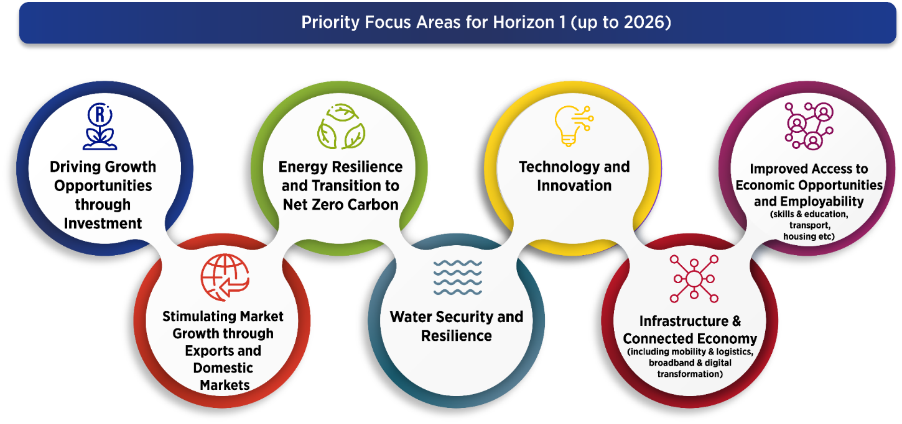
PFA 7: A holistic, inter-connected approach

Slide 5

Improved Access to Economic Opportunities and Employability
Youth and the unemployed can make INFORMED CHOICES about their careers and future and are enabled to pursue their career pathways
Citizens have easier access to economic opportunities and pathways nearer to the places that they live.
A strong PIPELINE OF SUITABLY QUALIFIED PEOPLE who are employment-ready, able to access available jobs and be absorbed rapidly and sustainably into employment.
Western Cape school leavers/graduates have a REPUTATION FOR TECHNICAL EXPERTISE coupled with and are highly sought after by employers INNOVATION/CREATIVITY/PROBLEM-SOLVING AND COLLABORATION SKILLS
Picture of Success
ENTREPRENEURSHIP is considered a viable choice as an economic opportunity and citizens starting up a business – whether formal or informal – have access to the necessary support and enabling environment
Changing the view of TOWNSHIP ECONOMIES from latent informal business to potential value chain business or suppliers in specific sectors would open opportunities for township-based entrepreneurs to participate more favourably in industry value chains
Townships are vibrant and dynamic economic places contributing to and benefitting from break-out economic growth
Notes:
2035 Picture of Success
Youth and the unemployed can make informed choices about their careers and future and are enabled to pursue their career pathways.
Citizens have easier access to economic opportunities and pathways nearer to the places that they live.
A strong pipeline of suitably qualified people who are employment-ready, able to access available jobs and be absorbed rapidly and sustainably into employment.
Western Cape school leavers/graduates have a reputation for technical expertise coupled with innovation/creativity/problem-solving and collaboration skills and are highly sought after by employers.
Entrepreneurship is considered a viable choice as an economic opportunity and citizens starting up a business – whether formal or informal – have access to the necessary support and enabling environment.
Changing the view of township economies from latent informal business to potential value chain business or suppliers in specific sectors would open opportunities for township-based entrepreneurs to participate more favourably in industry value chains.
Townships are vibrant and dynamic economic places contributing to and benefitting from break-out economic growth.

Slide 6
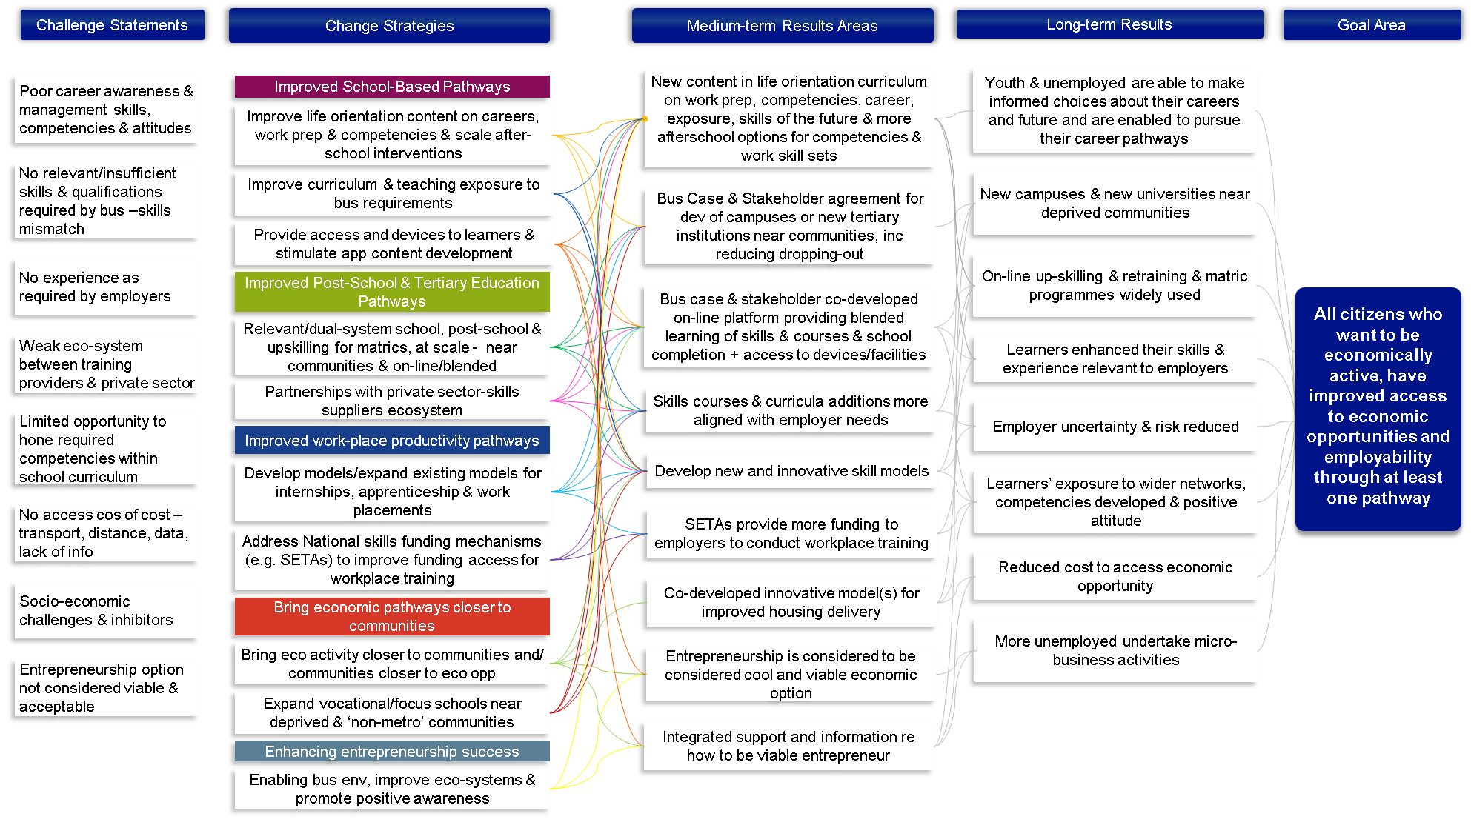
Theory of Change for Improved Access to Economic Opportunities and Employability

Slide 7
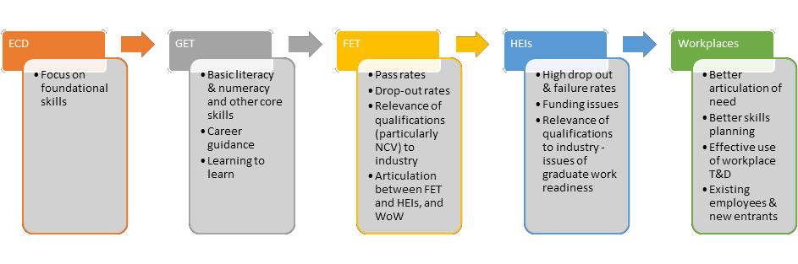

Current pathways
WOMB - TOMB; HOME -WORK; LIVELIHOOD – LIFE-JOY
Notes:
Inclinations Assessment

Slide 8
G4J - 6 Themes and interventions fall along the path ( aim to enhance)
1. Improved education-based and
competency-based pathways
2. Improved post-school
and tertiary education partners
3. Improved work-place skills and productivity
pathways
4. Bringing economic pathways and opportunities closer to citizens and communities and vice versa
5. Enhancing entrepreneurship pathways
6. Strategic Co-ordination and strengthened eco-systems
Notes:
Inclinations Assessment

Slide 9
Improved Access to Economic Opportunities and Employability Themes & Interventions
1
2
Improved education-based and
competency-based pathways (5)
Improving life orientation content on careers, work-readiness and competencies
Expanding after-school programme to develop competencies
Revising curriculum and modes of learning to maximise relevance to the workplace- 3 Streams
Accelerating the roll-out of focus schools and increase scale and geographic coverage of these schools
In partnership with the private sector, rolling out online blended learning
Improved post-school
and tertiary education partners (2)
Investigating the feasibility and develop a strategy to expand the number of universities (private sector and public sector) and Technical Vocational Education and Training (TVET) colleges in the Western Cape
Together with the tertiary institutions, enhancing the through-put rates of enrolled tertiary students
4
Bringing economic pathways and opportunities closer to citizens and communities and visa versa (8)
Overcoming the digital divide devices, connectivity, and relevant learning content available and aby making ccessible to all learners
Creating mixed-use, high density and compact settlements
Developing a vibrant, functional housing market as well as a land assembly pipeline to promote affordable, better located, more integrated housing opportunities and access to housing ladder
Work with municipalities to support homeowner-driven small scale development
Improving public transport to reduce commuting times
Developing an overall Western Cape township strategy as well as township action plans within targeted communities
Considering whether programmes such as the WCG’s Year Beyond Programme and EPWP can be used to assist skills transfer into township-based growth opportunities
Improving urban management in townships to support investment, enabling the development of economic nodes and commercial activities
3
Improved work-place skills and productivity
Pathways (7)
Developing initiatives to enhance experiential learning, as well as knowledge exchange
Exploring how the DEDAT’s BPO work placement model can be replicated for growth opportunities
Developing innovative models for micro-certification of modules from credible tertiary institutions rather than long-term accredited skills programmes.
Working with the private sector re their hiring practices
Strengthening dialogue between SMMEs and SETAs to increase funding to non-corporate businesses
Forging closer relationships with the Presidential Employment Stimulus team and YES initiative to better leverage and reorientate these support packages
Championing and investing in programmes to deliver digital skills relevant to the workplace at scale (see Tech and Innovation PFA).
Notes:
Actions towards 2035 success
1. Improved education-based and competency-based pathways
Improving life orientation content on careers, work-readiness, and competencies
Expanding after-school programme to develop competencies
Revising curriculum and modes of learning to maximise relevance to the workplace
Accelerating the roll-out of focus schools
In partnership with the private sector, roll out an online blended school for those who have not completed their schooling
2. Improved post-school and tertiary education pathways
Investigating the feasibility and developing a strategy to expand the number of universities (private sector and public sector) and TVET colleges
Together with the tertiary institutions, enhancing the through-put rates of enrolled tertiary students.
3. Improved work-place skills and productivity pathways
Through the improved understanding of businesses’ skills needs, developing initiatives to enhance experiential learning
Exploring how the DEDAT’s BPO work placement model can be replicated for growth opportunities
Developing innovative models for recognising emerging trends of training
Working with the private sector with respect to their hiring practices
Strengthening dialogue between SMMEs and SETAs
Forging closer relationships with the Presidential Employment Stimulus team and the private sector
Championing and investing in programmes to deliver digital skills
4. Bringing economic pathways and opportunities closer to citizens and communities and vice versa
Overcoming the digital divide by making devices, connectivity, and relevant learning content available and accessible to all learners
Creating the enabling environment
Developing a vibrant, functional housing market as well as a land assembly pipeline
Work with municipalities to support homeowner-driven small scale development
Collaborating with the PFA 6 with respect to improving public transport to reduce commuting times
Developing an overall Western Cape township strategy as well as township action plans within targeted communities
Considering whether programmes such as the Western Cape Government’s Year Beyond Programme and the Expanded Public Works Programme can be used to assist skills transfer into township-based growth opportunities
Improving urban management in townships to support investment

Slide 10
Improved Access to Economic Opportunities and Employability Themes & Interventions
5
6
Enhancing entrepreneurship pathways ( 8)
Understanding the impact of compliance enforcement on local businesses, and develop more incremental, affordable, and empowering systems where necessary.
Leveraging existing digital entrepreneurial platforms to provide support to entrepreneurs, providing information and a community of guidance to start-ups and those who want to expand.
Supporting opportunities for microbusiness support for women
Identifying and address challenges and ease of doing business, including the concerns about crime and safety, within the environment for entrepreneurs/microbusiness
Developing campaigns to promote entrepreneurship and microbusiness.
Conducting an international benchmarking of South Africa’s labour legislation and regulations, as well as assist business compliance with respect to labour relations regulations.
Supporting the entrepreneurship pathway from skills (business skills) to SMME support, to SMME development through supplier development in the public and private sector
Developing school-based collaborative programmes with private sector that supports youth start-up businesses
Strategic Co-ordination and strengthened eco-systems (2)
Increasing economic IQ about learning, schools, entrepreneurship, and microbusiness, providing open data
Strengthening the learning ecosystem and forums of learning institutions to support relevant learning
Notes:
5. Enhancing entrepreneurship pathways
Understanding the impact of compliance enforcement on local businesses
Leveraging existing digital entrepreneurial platforms to provide support to entrepreneurs
Supporting opportunities for microbusiness support for women, including ECD
Identifying and address challenges and ease of doing business, including the concerns about crime and safety
Developing campaigns to promote entrepreneurship and microbusiness.
Conducting an international benchmarking of South Africa’s labour legislation and regulations
Supporting the entrepreneurship pathway from skills (business skills) to SMME support
Developing school-based collaborative programmes with private sector
6. Strategic coordination and strengthened ecosystems
Increasing economic IQ about learning, schools, entrepreneurship, and microbusiness, providing open data
Working with the private sector, including training institutions, to enhance the relevance of skills and education training and to reduce the skills mismatch

Slide 11
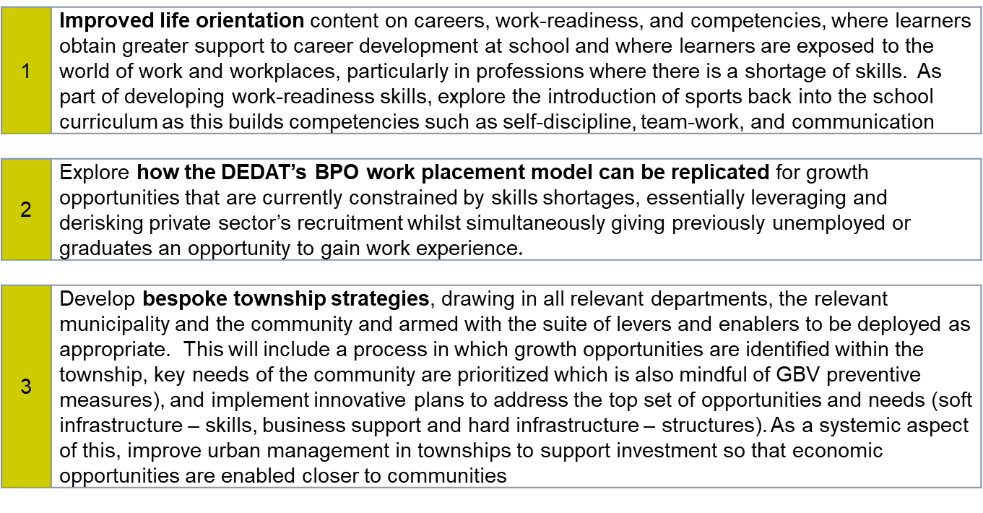
Improved Access to Economic Opportunities - Flagship projects for 2023/24

Slide 12
Improved Access to Economic Opportunities - Projects for 2023/24
 | PFA | Theme | Interventions | Projects – 1
1 | PFA: Employability | Improved education-based and competency-based pathways | Improving life orientation content on careers, work-readiness and competencies | Career Clubs in Schools
No | PFA | Theme |  | Projects – 4
9. | PFA: Employability | Improved work-place skills and productivity pathways | Exploring how the DEDAT’s BPO work placement model can be replicated for growth opportunities that are currently constrained by skills shortages | ED Support: Labour Relations Compliance Growth through experiential learning & jobs – Clothing & Textiles Improved work-place skills and productivity pathways – BPO Three Streams Model
The implementation of Year 1 Project plans will speed up after the approval of the Implementation Plan in June.
Project plans for Year 2 will be submitted in the next phase

Slide 13
Key Aspects of the WCED-DEDAT response

Slide 14
DEDAT’s Skills Strategy in Support of PFA 7
In the Long-Term actively pursue a strategy that negates the need for a DEDAT skills priority.
In the medium term develop curricula/training modalities that negates the need for DEDAT post school intervention.
In the short-term support growth through improvements in labour productivity, fulltime employment and support demand through a supply-side instrument.
Our strategy is G4J - experiential learning is the most direct manner in delivering jobs.
Long-term & Systemic:
Ecosystem alignment
Medium Term:
Curricula alignment
Immediate Impact:
Experiential Learning Programmes
Strategic Co-ordination and strengthened eco-systems
A self-correcting skills ecosystem sensitive and responsive to changing industry demands.
Expand public and private education institutional offerings aligned to industry skills needs - support public TVET dual
Extensive work with basic and higher education to bring about alignment between industry and academia
Align funding windows, areas of funding and funding requirements with changing industry requirements.
Develop and support institutional responsive structures
Improve education-based and post school education pathways
Introduce new and/or refine curricula and training modalities across higher education and basic education more suited to ever changing industry demands.
New modalities in delivering curricula including new delivery (digital modalities (reach and scale)
CBMT in Schools partnership with private sector and WCED – THS learners gain more practical skills to improve employability.
SETA support for STEAMAC (pilot of 3 year support from FoodBev SETA).
Improve workplace skills and productive pathways
Replicate the BPO workplace model to other sectors
Transitioned more than 5000 unemployed youth into employment via experiential learning.
…. of which 80% of beneficiaries who complete their experiential learning will be transitioned into fulltime employment.
Crowd in more than R500m in financial support.
R360m increase in household income
Explore on the job training and non-accredited training that lends to employment (NEETS)

Slide 15
DEDAT’s Entrepreneurship Promotion in Support of G4J
Context:
  Entrepreneurship, like capital, is a critical factor of production
  SA problem: LOW start-up rate of new businesses and HIGH failure rate of existing businesses
  Some key inhibiting factors:
    A “not-so-encouraging” entrepreneurship culture in communities
    Not an option for young people, “Get a job …. “
    Inadequate support (financial and non-financial) eco-system …. both in terms of business stage of development (e.g., start-up) and geographical distribution (urban vs rural)
    Poor levels of education and training
    Red tape and government bureaucracy - regulatory constraints (e.g., rigid labour laws)
    Availability of technical and industry-specific training (e.g., artisans becoming entrepreneurs)
Our Response:
  Realise & accept that the economy and entrepreneurship is critical for our prosperity
  Let's do this together - all 3 spheres of gov & agencies, tertiary education, private sector, support organisations
  Selected key thrusts:
    Regulatory reform and reduction of government bureaucracy (Red Tape Reduction Programme)
    Province and district-wide entrepreneurship promotion (e.g., events, workshops, training)
    Supplier development (public sector local suppliers)
    Private & public sector business opportunity linkages
    School and post-school entrepreneurship promotion & development
    Township and informal business support
    Women, start-ups & youth as key themes

Slide 16

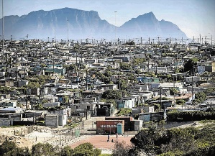

DEDAT’s Township Growth in Support of G4J
Context:
  Need to include those excluded from the economy because of e.g. (lack of) skills & income, geography
  Rationale for supporting township & informal sector
      Historical and existing social deprivation with concomitant unemployment, poverty & feelings of hopelessness
      Means to address challenge of urbanisation and in-migration
      Potential enormous economic opportunities to contribute significantly to the “mainstream” economy
Our Response:
  Finalisation of a township economic growth strategy (TEGS)
  Selection of about 2 pilot sites for implementation
  Key thrusts:
    Spatial Planning
    Regulatory reform
    Enterprise development & business support
    Infrastructure (social and economic)
    Skills development and training
    Crime (and extortion)
    Technology and innovation

Slide 17
WCED response overview
The WCED has welcomed and embraced its dedicated inclusion in the WCG Economic Development
Planning process – G4J.
  It provides the opportunity to enhance the WCG work done before in the Skills De elopement pipeline to strengthen the relationship between SCHOOLS , TERTIARY EDUCATION, WORLD of WORK, and SOCIETY
  Schools can become more responsive developing better readiness for TERTIARY EDUCATION, WORLD OF WORK and CITIZENSHIP roles
  The WCED has received presentations from G4J Seco, made inputs to the development of the Strategy, allocated officials to this and other PFAs, and included the work in the Performance Agreements of relevant officials
  The WCED is appreciative of being made the PFA lead department for PFA 7 and to work with all the WCG Departments on the initiative as a whole and in the PFA specifically.
  Through this, the intervention on Career Awareness has acquired an inter-departmental and whole of society platform that can lead substantially increased awareness and choice-making
  The 3 Streams model ( Academic, Technical and Vocational) can be enhanced through a wider set of partnerships within WCG and across private and community sectors.

Slide 18
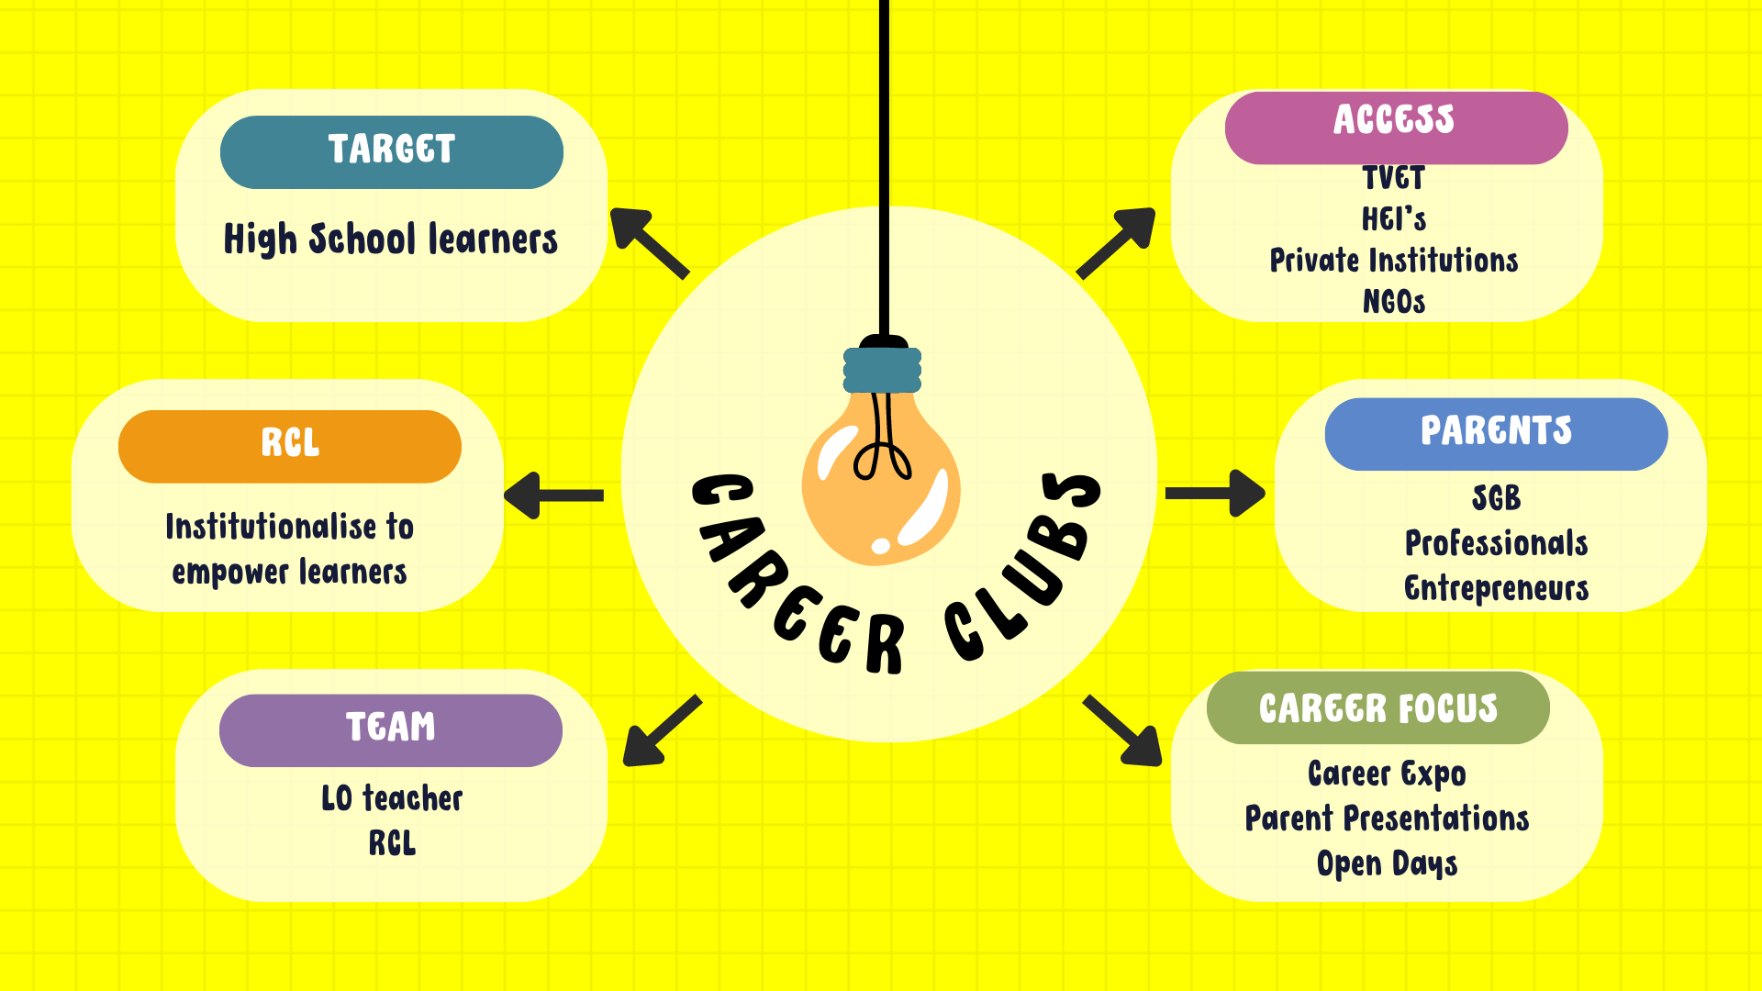
FLAGSHIP 1: Life Orientation – Establish Career clubs in all schools
Outcomes:
Learners that are self-confident; have good self-esteem and understands his/her interests and abilities.
Learners that have a full understanding of the career landscape.
Well-informed learners that are enabled to make confident career choices.
Learners that understand the entrepreneurial mindset.
Notes:
Aims and objectives:
To offer learners opportunities to engage in activities that will improve self-confidence; self-esteem and understanding of his/her strengths, interests and abilities.
To expose learners to different career fields, including the changing nature of careers in the 21st century.
To serve as a support base for learners to develop into well-informed individuals enabled to make confident career choices.
To create opportunities for learners to develop an entrepreneurial mindset.
To develop and sustain capacity in the development of Career Clubs at all high schools.
To create an enabling environment for learners to take ownership of their career path

Slide 19
CAREER CLUB ACTIVITIES
PBL develops entrepreneurial mindset
Learner led sessions
Invite speakers
WHO AM I? Strengths, Abilities & Interests
Career Research
Career Expos; Workplace exposure & excursions

Slide 20
APP Targets
3 Streams - Emergent Policy Implementation aiming to increase access learning pathways
  ACADEMIC ( 97%)
  General, formative, well-rounded Post School Education & Training studies
  VOCATIONAL
  Broadly aligned to a vocation ; Both ordinary and Focus
  OCCUPATIONAL - preparing learners for the workplace
SoS etc
Focus Schools such as Technical, Agricultural, and Art high schools
Outcome | Outcome Indicator | Baseline 2018/19 | Five Year target
Increase access to Technical, Agricultural, Vocational and Skills subjects and schools | Percentage of learners who offer at least one subject in the technical, agricultural, vocational and skills fields. | 6% | 12%

Slide 21
WCED approach
3 Streams
Tech/SoS
26 Tech + 26 SoS
10 Subjects-FET; 13 Subjects- GET
FOCUS SCHOOLS (30)
7 MST, 3 X BCM, 3 X Agric, 4 X Engineering, 3 X ICT, 5 X Arts, 2 X Maritime and Marine, 3 x Service)
E3(Entre/Empl/Educ)
Pilot
550 schools

Slide 22
List of Current Technical schools in WC
 | Education District | School Name |  | Education District | School Name
1 | Metro Central | Intshukumo SS | 14 | Metro South | Oval North SS
2 | Metro Central | Oude Molen THS | 15 | Metro South | Wynberg Boys High
3 | Metro Central | Spes Bona THS | 16 | Metro South | Princeton SS
4 | Metro East | Joe Slovo Engineering | 17 | Eden - Central Karoo | Beaufort West SS
5 | Metro East | Kuils River THS | 18 | Eden - Central Karoo | Langenhoven Gymnasium
6 | Metro East | Northpine THS | 19 | Eden - Central Karoo | Morester SS
7 | Metro East | Sizimisele THS | 20 | Eden - Central Karoo | Eden THS
8 | Metro East | Bellville HS | 21 | Cape Winelands | Drostdy THS
9 | Metro East | Bellville THS | 22 | Cape Winelands | Esselenpark SS
10 | Metro North | Delft THS | 23 | Cape Winelands | Labori THS
11 | Metro North | Kasselsvlei Comp HS | 24 | Cape Winelands | Jakes Gerwel THS
12 | Metro North | Proteus THS | 25 | Overberg | Groenberg SS
13 | Metro North | St. Andrew's THS | 26 | West Coast | Weston SS

Slide 23
What is a School of Skills (SoS?
Learners who are unable to cope with the curriculum offered at public ordinary schools and who need an alternative adapted curriculum, are enrolled at a School of Skills.
In the Western Cape, the Schools of Skill are special schools.
They offer a learning pathway that equips learners with the relevant skills to join the world of work.
Schools are encouraged to have a 4th year school-to-work programme.
They establish links with industry and place learners with host companies for workplace exposure in the hope that they will offer learners full-time employment upon completing their programme.
We need industry to open their doors for School of Skills learners to do job-shadowing and gain workplace exposure.
We also need companies to link with our schools and provide job opportunities to our learners.

Slide 24
Schools of Skill in the Western Cape .
Metro South | Metro Central | Metro East | Metro North
Cafda (Retreat) Mitchell’s Plain | Batavia (Lansdowne) Siviwe (Gugulethu) Silverstream (Manenberg) | Axios (Faure) Lathitha (Khayelitsha) Westcliff (Bellville) Bet-El (Kuilsriver) | De Grendel (Milnerton) Bishops (Bishop Lavis) Florida Ruyterwacht Atlantis

Slide 25
Schools of Skill in the Western Cape (continued)
West Coast | Cape Winelands | Overberg | Eden & Central Karoo
West Coast (Saldanha) Riebeeck Valley Special School (Riebeek-West) Graafwater | Paarl Steinthal (Tulbagh) Nuwe-Hoop unit (Worcester) Wellington Breede Valley (Worcester) Jakes Gerwel Technical (Bonnievale) | Agulhas (Napier) | Van Kervel (George) Olympia (George) Oudtshoorn

Slide 26
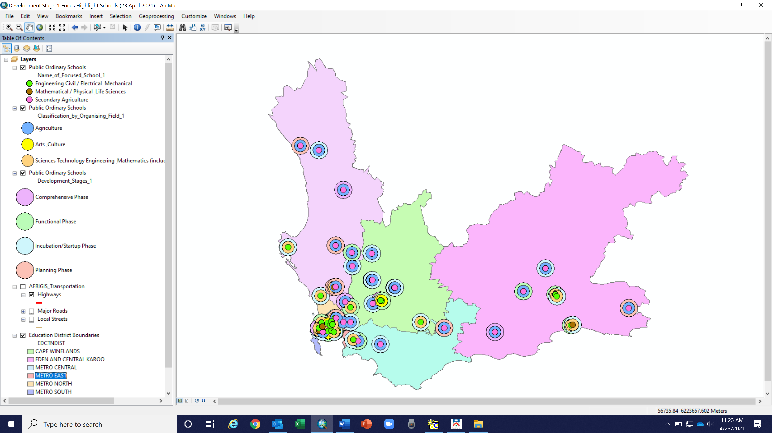
Map of current focus schools
Notes:
WCED Spread of focus schools – subject to change. (Those identified plotted as a list only)
Key note – Inside circle (FOCUS)
Second circle (Classification)
Third Circle (Possible Development stage)

Slide 27
How to plug in?
To take all of this forward more detailed discussion and is needed
HOW?
1. The transversal work across government departments can be strengthened
Implementation in districts and municipalities
2. Private sector and entities ( SETAs etc) can indicate where support can be committed

Slide 28
TMS Chase

